Slide 1
NIGHTINGALE
Novel Integrated Toolkit for Enhanced Pre-Hospital Life Support and Triage in Challenging and Large Emergencies
WHAT IS THE NIGHTINGALE TOOLKIT AND HOW IT IMPACTS THE EMERGENCY MEDICAL DOMAIN?
Presenters:
Spyros Athanasiadis (ICCS), member of the coordination team

Slide 2
Presentation Contents
NIGHTINGALE objectives
NIGHTINGALE Tools
INFAFRI Capabilities provided
NIGHTINGALE Benefits for end-uses
TRAINING MATERIAL + Public deliverables
Notes:
Presentation Contents

Slide 3
NIGHTINGALE Objectives
Optimise current procedures and methods of triage and pre-hospital life support.
Enhance the operational capacities of emergency medical services in the event of mass casualty incidents.
Offer intelligent, integrated, and interconnected technological solutions for emergency teams.
Develop a commonly agreed operational framework for multi-agency emergency response.
*”A mass casualty incident (MCI) describes an incident in which emergency medical services resources, such as personnel and equipment, are overwhelmed by the number and severity of casualties.^{[1]} ”
Notes:
Project objective achieved:
Optimise current procedures and methods of triage and pre-hospital life support
Enhance the operational capacities of emergency medical services in the event of mass casualty incidents
Offer intelligent, integrated, and interconnected technological solutions for emergency teams
Develop a commonly agreed operational framework for multi-agency emergency response
and further a figure with the:
Round tables,
Table Top eXercises (TTX)
Small Scale eXercise (SSX)
2 MACSIM system based simulation and the
2 Full Scale eXercises (FSXs)
Conducted to evaluate and finalize the technologies while validating the NIGHTINGALE toolkit.

Slide 4
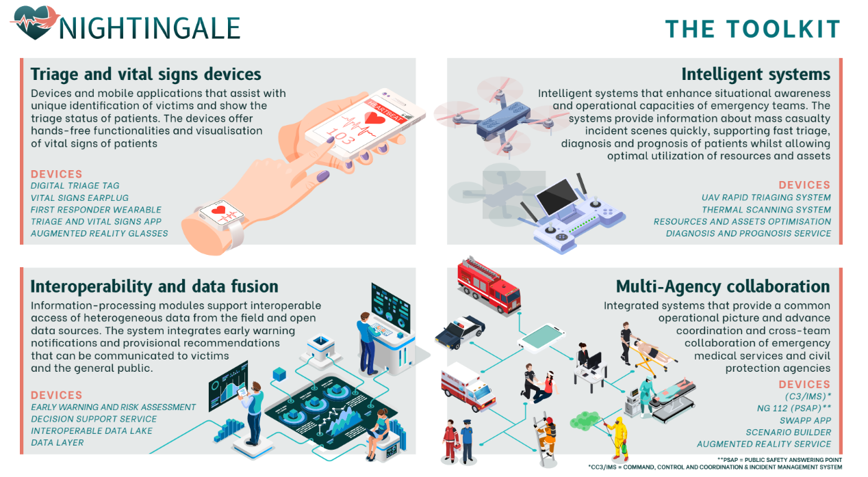

Slide 5
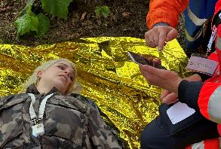
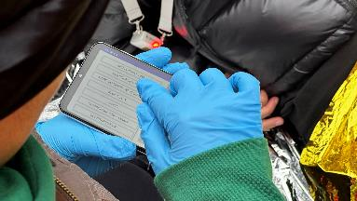
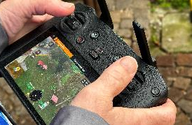
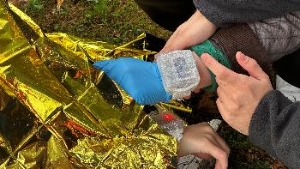
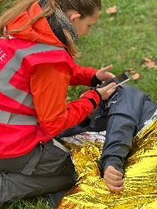
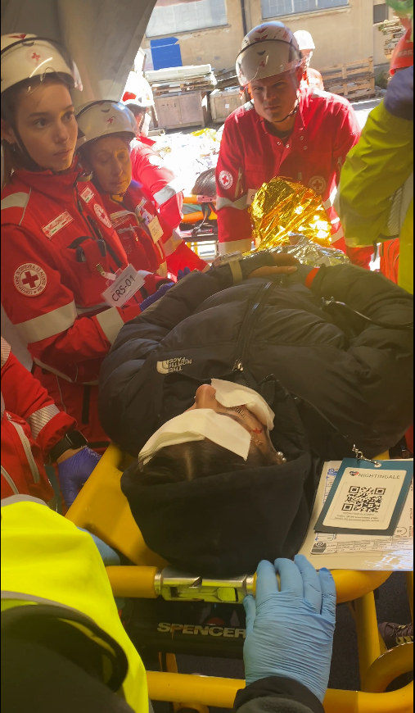
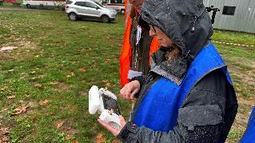
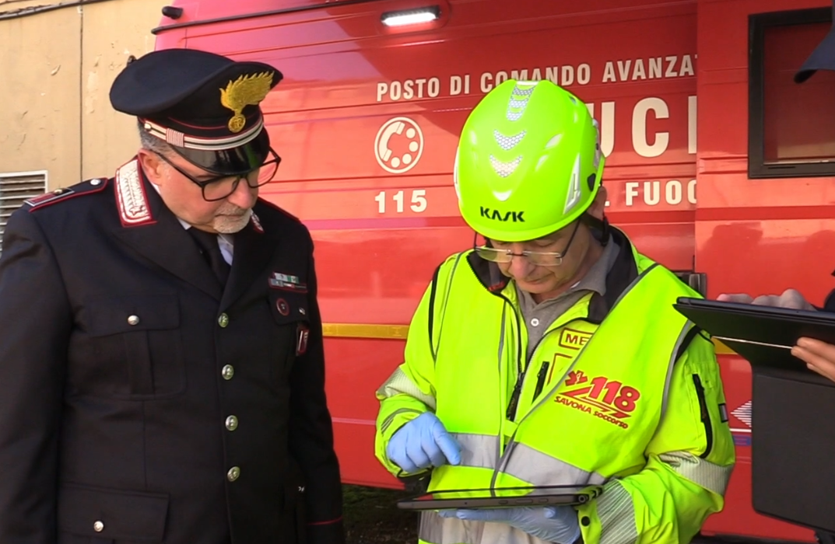
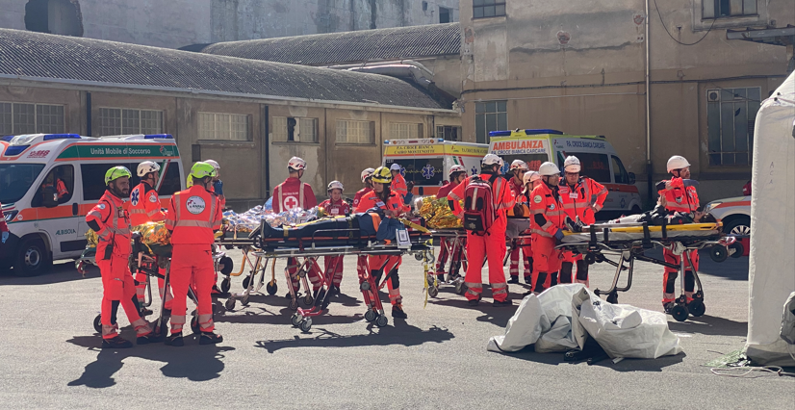
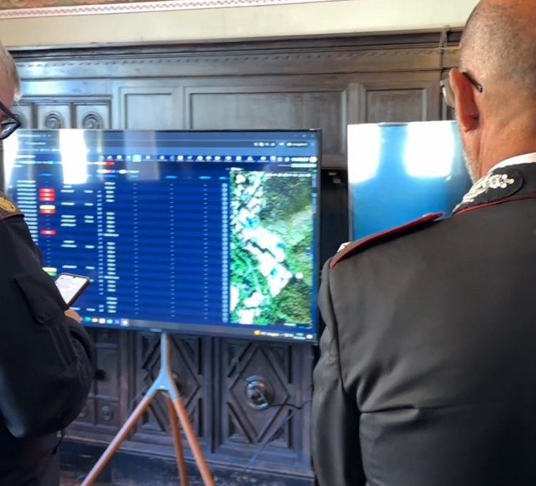
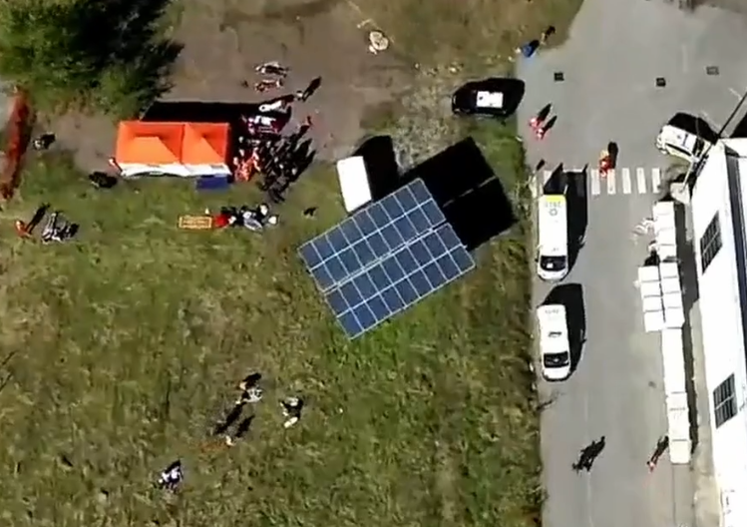
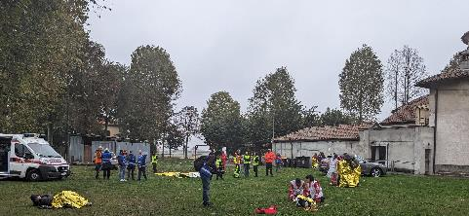
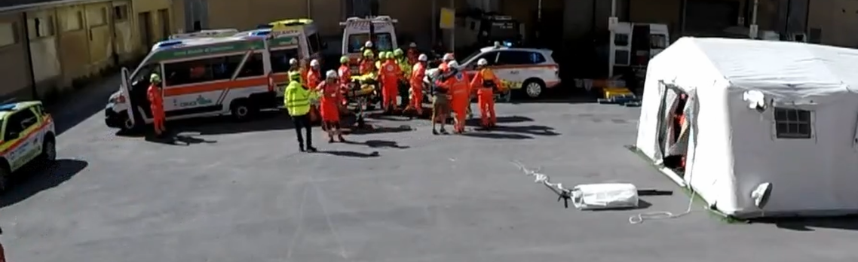
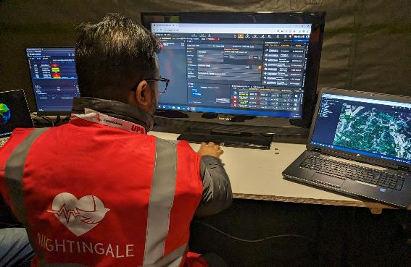
NIGHTINGALE – SSX / FSX
 | SSX | 1st FSX | 2nd FSX
Organized and hosted | UPO | SAMU | MININT and ASL2
Scenario duration | 4rounds x 30minutes each | 4 hours | 6 hours
Victims | 25 | 30 | 90
Players | 22 | 48 | 230
NIGHTINGALE toolkit in each pilot deployed in 2 different location (command center and field)
Immediate awareness about the incident in all agencies and teams
Teams at the command center and the field (Incident Commander) had the same view of the operations
Triage information/data were available at command center and at any potential agency has a command center (example hospital, civil protection, etc).
  Information was transmitted in less than 2 seconds (in all locations field/command center/hospitals/etc) with no data loss.

Slide 6
NIGHTINGALE Toolkit

Slide 7
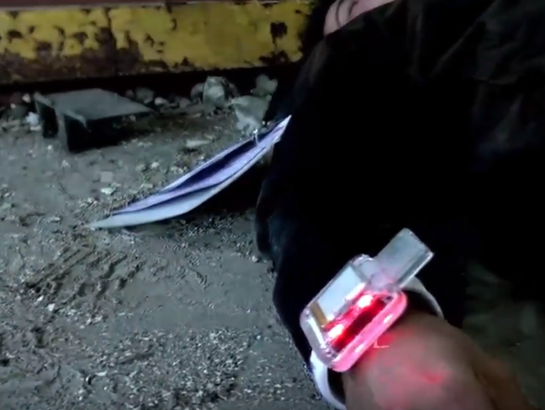
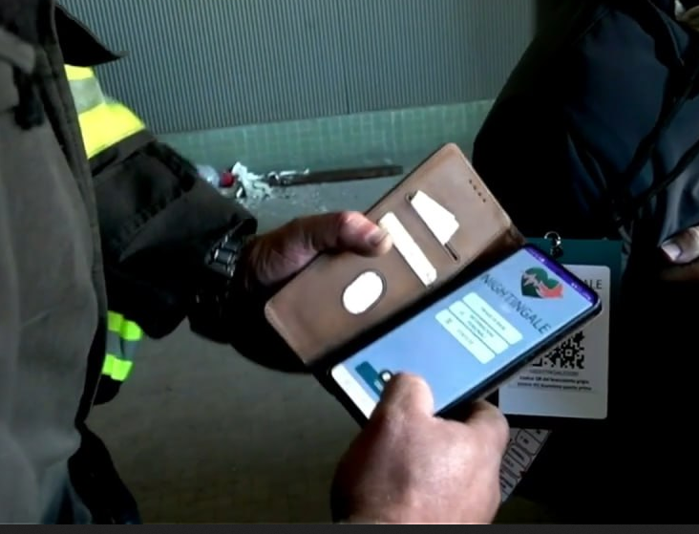
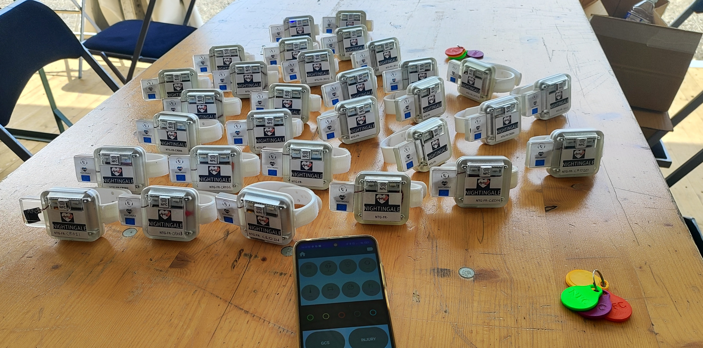
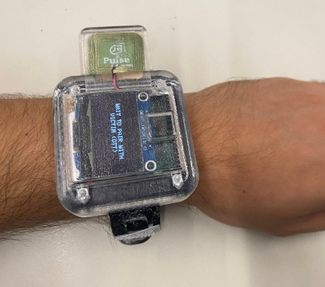
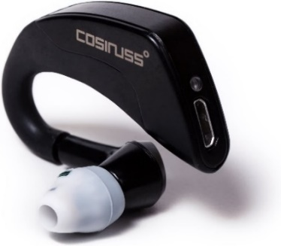
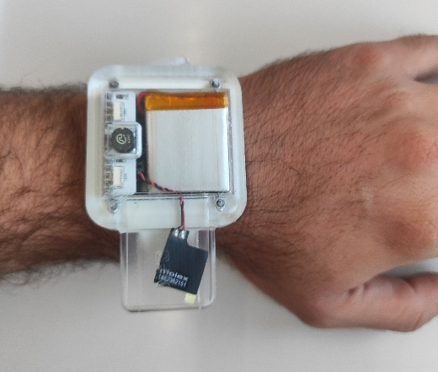
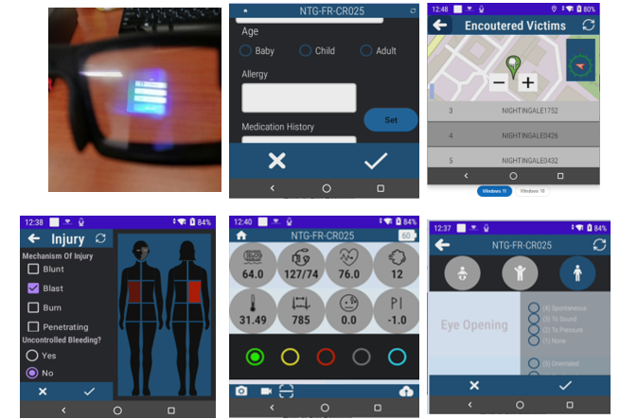
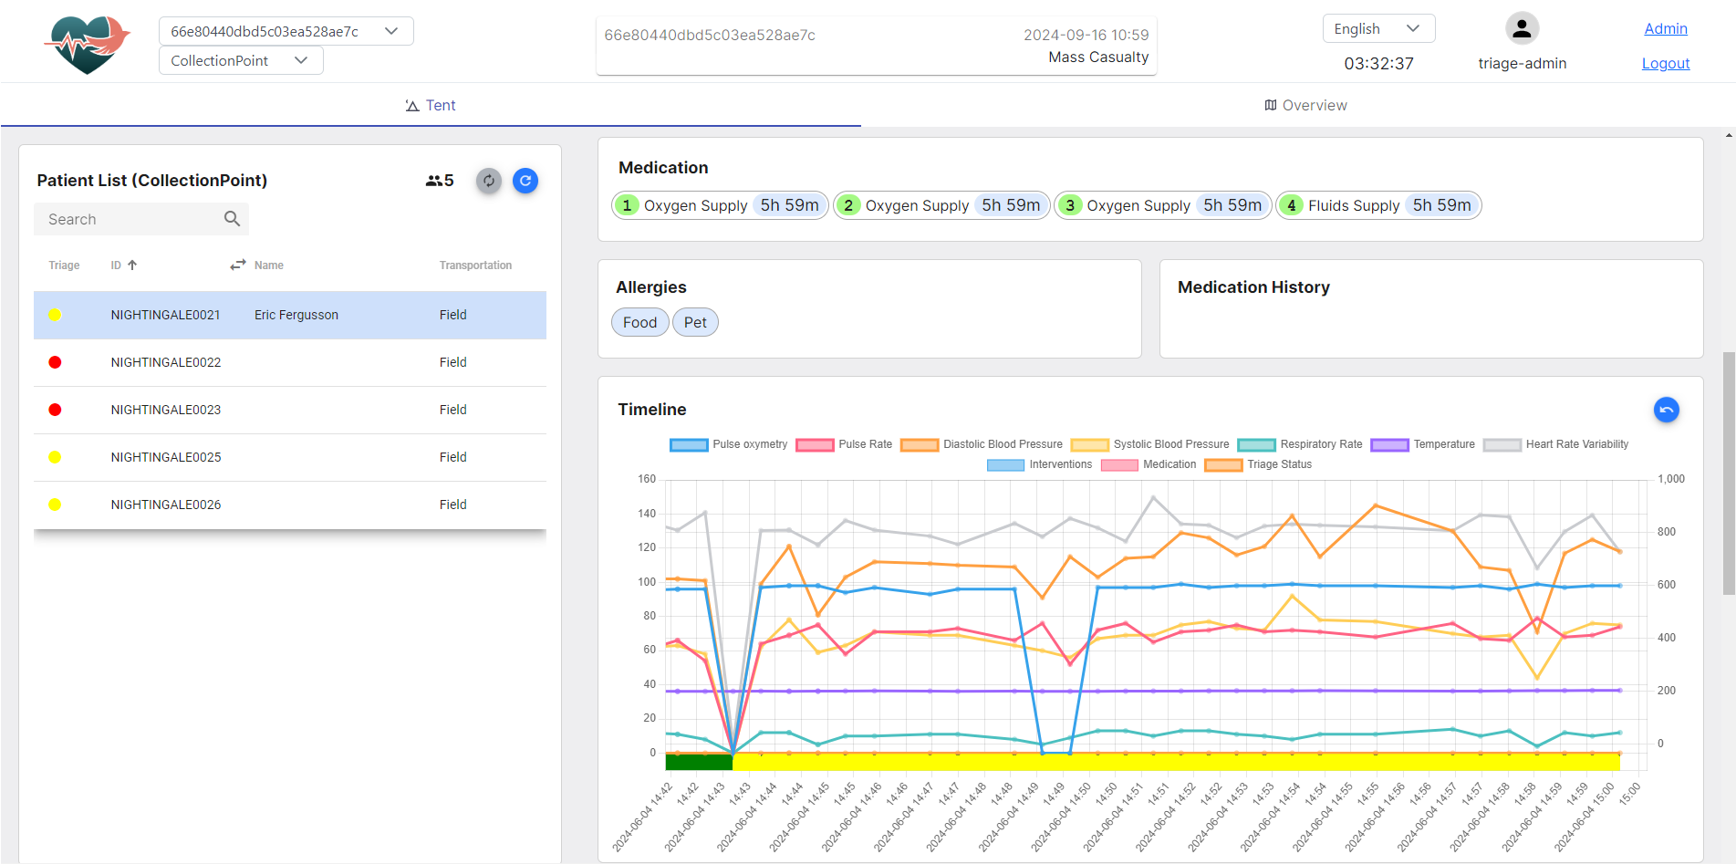



Digital Triage Toolkit – FSX2 Highlights
Successfully tested in three Trials (SSX, 2 FSX), including one involving 80 simulated victims and 200 first responders (FSX2)
FSX2 Highlights
  Stage 1 – Law enforcement/fire brigade:
  30 GREEN victims (ambulatory) registered in 6 minutes, along with name, surname, identification photographs and location.
  15 RED/YELLOW victims registered in 6 minutes with identification photographs, wounds
  Stage 2 – first Triage/Second Triage:
  Data of 90 victims monitored in real time.
  All victims registered within 38 minutes and fully monitored from that time onwards. All victims extracted to AMP in 57 minutes
  30 Victims with DTTs transmitting vitals every 30 seconds.
  Total users:
  40 law enforcement – Using light version (no medical data)
  20 fire brigade – Using light version (no medical data)
  36 medical users – Using full version
Notes:
Proven Deployment in Realistic Scenarios: The digital triage solution was successfully tested in three major exercises, including one involving 80 simulated victims and 200 first responders.
Field-Proven Reliability: Demonstrated robust functionality during multi-location deployments, confirming its viability in real-life mass casualty response scenarios.
Secure and Efficient Communication: Enabled secure and real-time data exchange between different first responder teams and command centers, promoting coordinated response efforts.
Instant Awareness and Synchronization: Upon incident reporting, all tools and agencies (varied first responder teams) were immediately notified, establishing an integrated awareness of the situation.
Real-Time Data Accessibility: Triaged victim data was instantly available to the command center and relevant agencies (e.g., hospitals, civil protection), ensuring comprehensive situational updates.
Rapid Data Transmission: Information transfer across all points—field locations, command centers, hospitals, etc.—occurred in less than two seconds, guaranteeing no data loss and swift response adaptability.

Slide 8
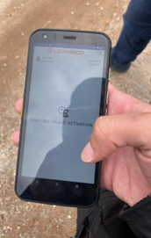
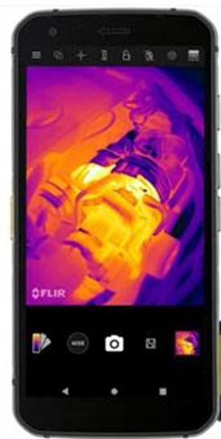
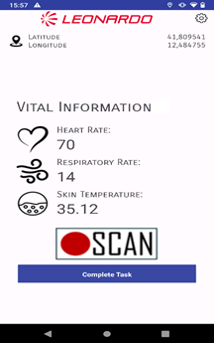

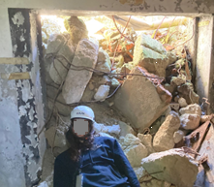

Thermographic Scanning System
Shares crucial information
  patient's location, photos, and vital parameters in a non-contact manner, particularly useful in cases were is not possible or not safe to use medical devices that need to be physically applied to casualties
Vitals parameters are extracted using Machine Learning algorithms
The TSS vital sign monitoring includes :
  a rugged smartphone (Cat S62 Pro) with thermal camera embedded;
  an Android APP to acquire data and show the results;
  a backend application that includes a machine learning model
    extracts heart rate, respiratory rate and skin temperature
In the 2° Full scale Exercise, the TSS was used by USAR operators for casualties under the rubble who could only be approached at a minimal distance
Edge Device (Cat S62 Pro)

Slide 9
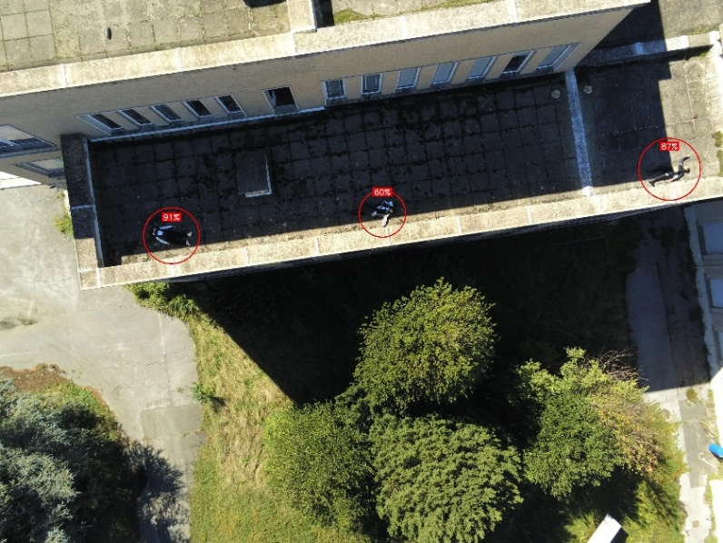
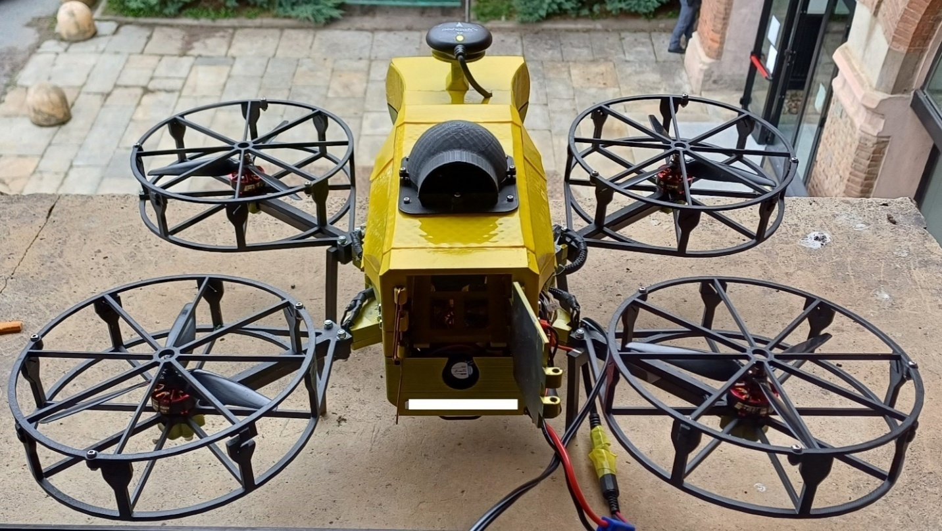
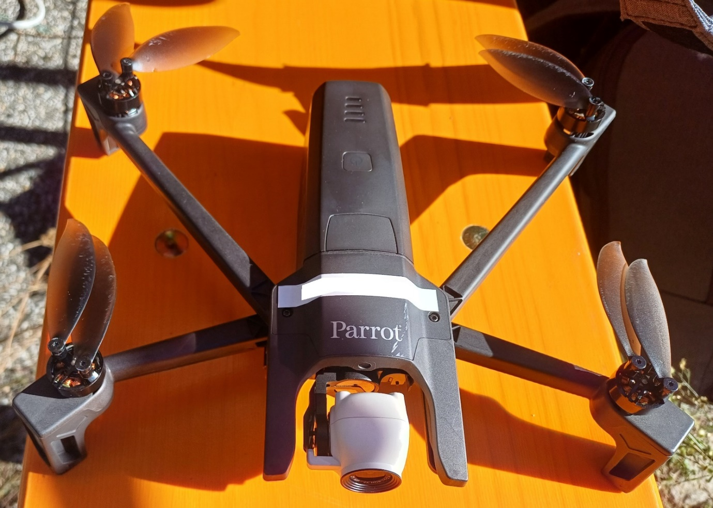

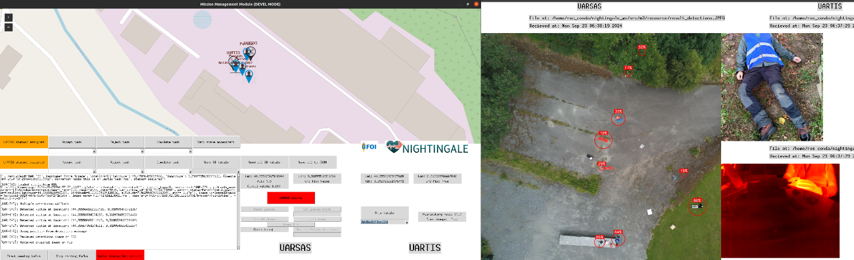
Drone components
The UAR-SAS (Unmanned Aerial Rapid Scene Assessment System) drone
The UAR-TIS (Unmanned Aerial Remote Triage Indicator and vital parameter estimation System) drone
The Ground Control station, GCS

Slide 10
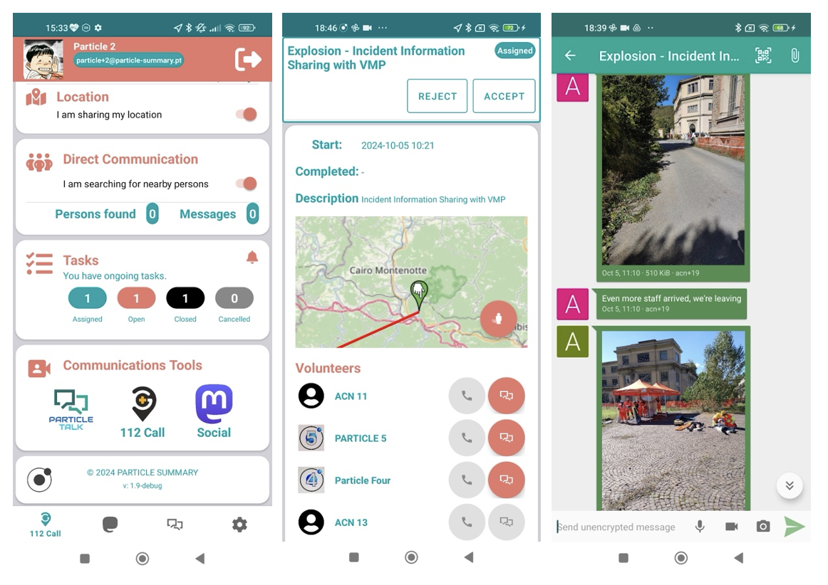
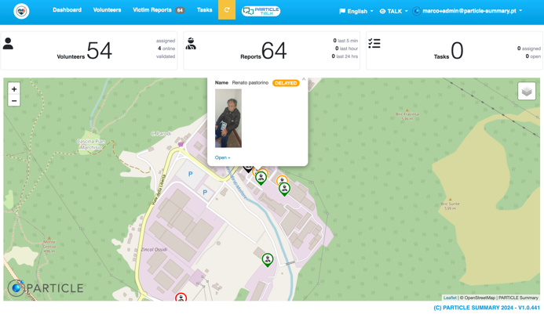
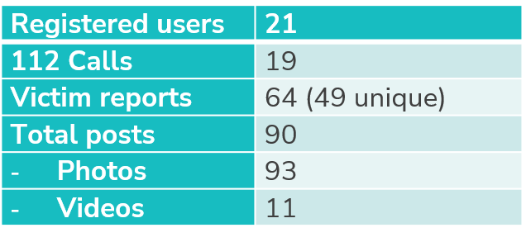



SWAPP: Citizens in Emergencies
SWAPP Enables citizens to
  contact NG112 Services to report emergencies
  register as volunteers
  accept volunteering tasks
  find and communicate with other volunteers (in video, audio and text)
  report victims.
Volunteer Portal
  manage and mobilise volunteers to assist in incidents.
  identifies the volunteers in the close vicinity of an incident
    with the right set of training, skills and competences to support the emergency response effort
NIGHTINGALE FSX2 main achievements:
  Active participation: 21 registered users
  64 victim reports (49 were unique), including name, gender, location and photo.
  90 posts done in social media, including 93 photos and 11 videos.

Slide 11
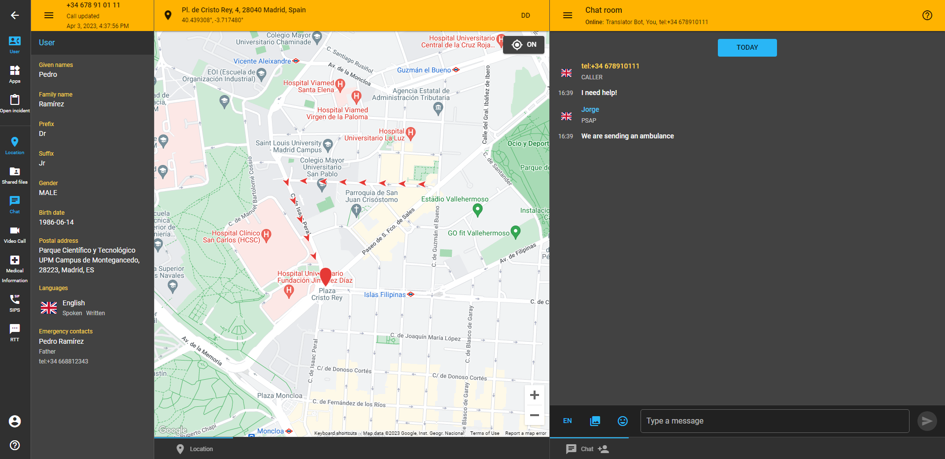
NG PSAP
The NG PSAP is a system that receives emergency calls from Apps using the PEMEA network. The NG PSAP implements also advanced capabilities which allow it to communicate with Apps using multimedia channels. It can use the following communication channels:
  Real Time Text (RTT): The RTT capability defines a chat where the characters are transmitted as they are typed, so all the participants in the chat can read what others are typing in real time.
  Instant Messaging (IM): The IM capability defines a chat where the users can write text messages.
  Audio Video (AV): This capability allows to add extra users to the call, like sign interpreters for example, so that deaf users can use a video call to communicate.
  File Exchange: The File Exchange capability allows the exchange of files between the participants.
  Public Alerting: The Apps can subscribe to public alerts in a certain region. If the PSAP of the region sends an alert, the Apps will receive it.
  Medical Information: The caller can pre-register some medical information. This medical information can be retrieved by the PSAP when the call arrives.
  Precise Location Update: The call is made using a precise location, during the call, the App can send updates of the user location and they will be retrieved by the PSAP.

Slide 12
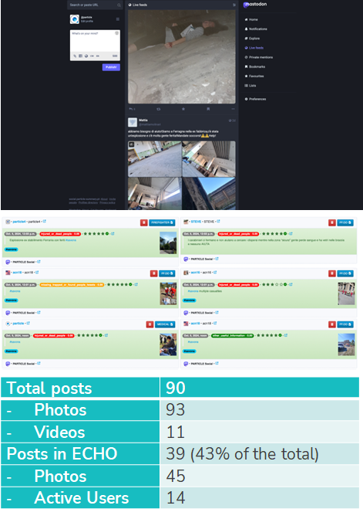
ECHO: Global Situational Awareness
Situational awareness tool for EMS designed to display a large volume of emergency-related information and mainly information originated from social media.
In the NIGHTINGALE FSX2, ECHO was managed by the Social Media Information Officer
  presented with potentially significant post messages
  verifying their content and relevance, validating their trustworthiness and forwarding them
Posts provided
  photos and videos of a building in smoke at the Ferrania site
  requests for help, indicating the presence of multiple victims with illustrative photos and videos
  images and videos of the first responders’ intervention at the scene.
NIGHTINGALE FSX 2 main achievements:
  90 posts, including 93 photos and 11 videos.
  ECHO identified, validated and forwarded 39 relevant posts (43% of the total), including 45 photos, from 14 active users, to the NIGHTINGALE C3I System and the First Responders.

Slide 13
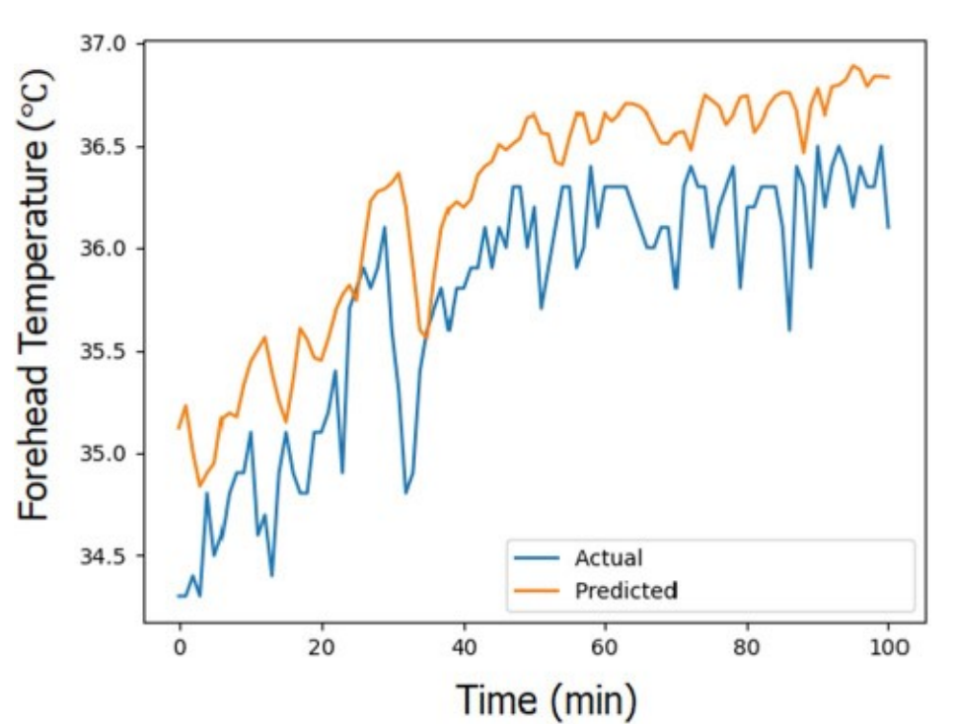
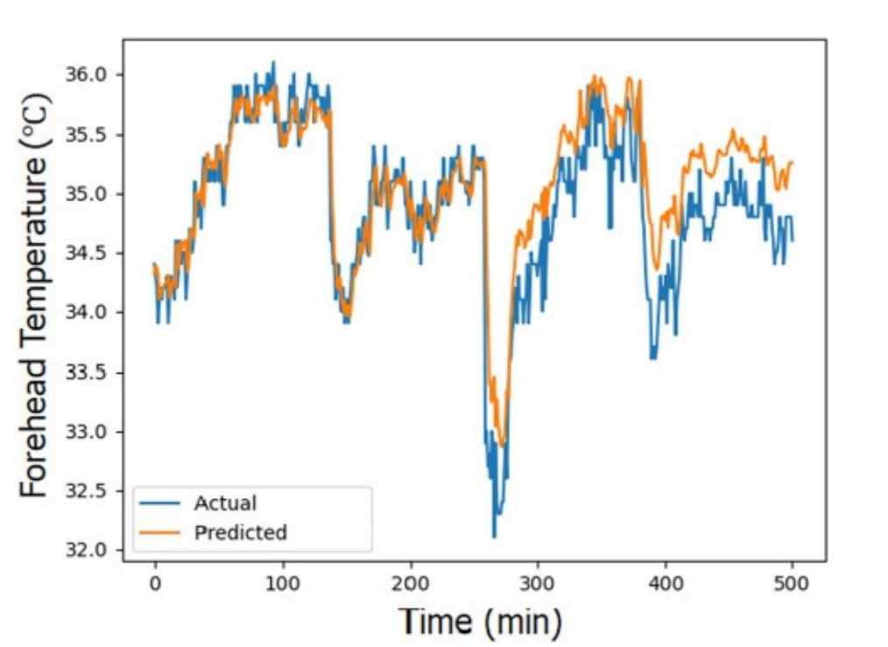
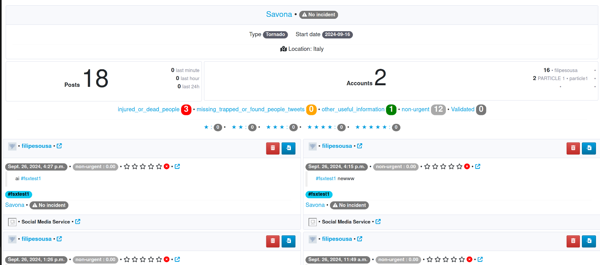
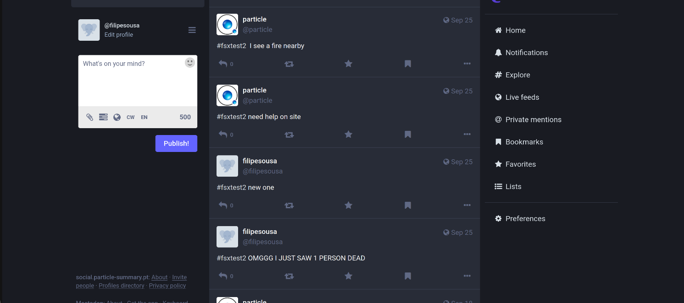
Smart Pro and Social Media
Smart Pro: SmartPro demonstrated its ability to accurately predict trends for heart rate, respiratory rate, systolic and diastolic blood pressure, and SPO2. It successfully retrieved patient data from the messaging gateway, analyzed the information to compute vital sign trends, and sent the results back to the gateway. Using these insights, the module calculated individual and overall early warning scores and identified alerts for potential airway, breathing, and circulation issues. When needed, the system recommended required patient interventions by leveraging the information collected from these assessments.
Social Media: the Social Media Information used to test the tool made by users during the trials have been placed on a private Mastodon network. The Social Media Service notified the ECHO system whenever a new post appeared.
All the tweets were extracted, categorized by the AI algorithm used by the SMS System and displayed in our Application Programming Interface (API) (through several different endpoints), as well as the statistics associated with the events being monitored.
Then all the information was displayed in ECHO (statistics of the event, all the posts extracted, and all the categorizations made by the AI algorithm).

Slide 14
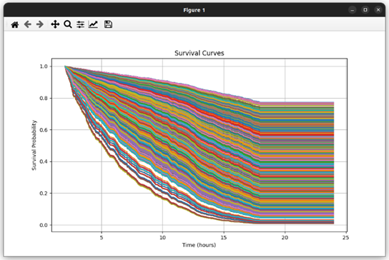

EDRA (Emergency Departament Allocation Tool) and VitalAI
EDRA:
Plans in real-time the assignment of patients to internal hospital resources, in order to minimize waiting times, prioritization of critical patients, and time of care.
During FSX2:
  The EDRA algorithm was able to efficiently allocate resources to patients.
  EDRA correctly gave priority to patients with a more serious condition.
  EDRA computation time was reasonable (less than one minute per 3 patients)
VitalAI:
Predictions on the probability of survival of patients based on ML algorithms and ranks from most to least critical patient.
During FSX2:
VitalAI managed to handle the predictions of approximately 60 victims at once
Predictions for casualties were made in an efficient computational timeframe (less than one minute)

Slide 15
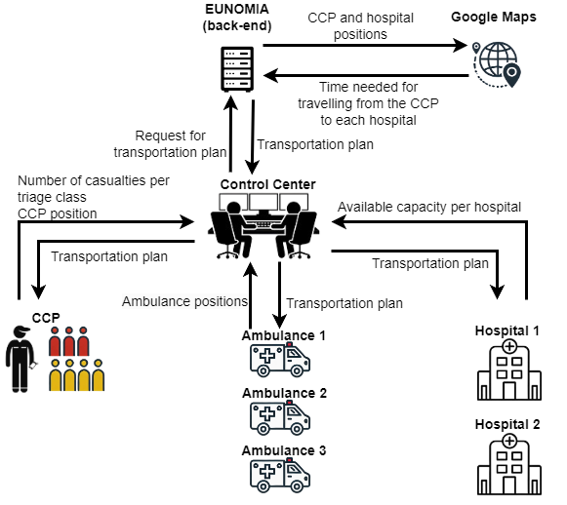
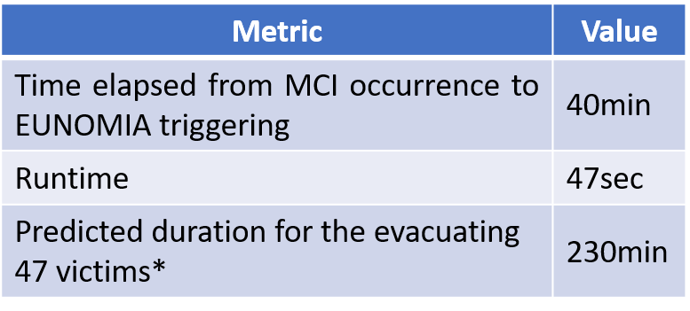
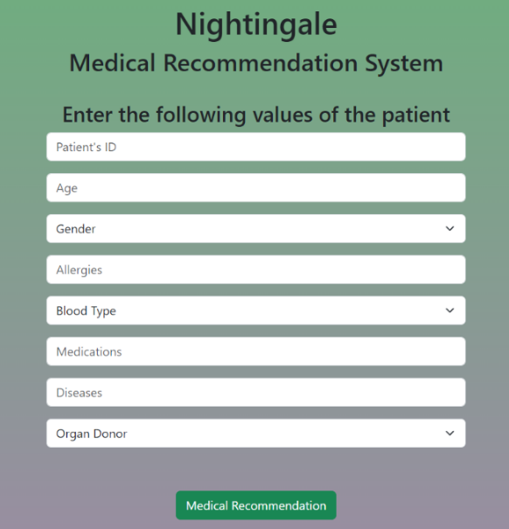


EUNOMIA
Decision-support tool.
It derives the optimal victim transportation plan (i.e. who, when and where).
Back-end component that operates at the Control Center.
FSX2’s performance metrics
Recommendation engine:
Recommendation Engine is responsible for analysing data from other NIGHTINGALE components in order to provide the respective alerts and recommendations to stakeholders. The Recommendation Engine uses as an input the medical health record inserted voluntarily by victims, demographics information, and interventions performed in the field. The outputs of this process are sent to the Data Layer, and also saved in the Data Interoperable Lake as historical data. In order to provide relevant alerts and recommendations, Recommendation Engine utilizes respective expert reasoning algorithms and with the usage of relative technologies, provides useful information to assist decision-makers.
* 12 ambulances were used to transfer the victims to 4 hospitals that were 27 to 41 min away from the MCI point

Slide 16

Patient predictive assessment and risk estimation module
Patient Predictive Assessment: The Patient Predictive Assessment is a back-end decision support tool, designed to facilitate real-time decision-making and improve patient outcomes in high-pressure situations. The tool uses Machine Learning (ML) models trained on Niguarda Hospital dataset, regarding trauma patients. The models use as input the vitals provided by TVSA to the Nightingale system, and other info relative to the victims, inserted to TVSA by the first responders, such as gender, age, GCS, triage and trauma type. The models process the input data and provide suggestions for each victim. Those suggestions concern medical interventions (airway assistance and massive blood transfusion) and pathological conditions (pre-hospital cardiac arrest, pneumothorax/hemopneumothorax) that require interventions performed by the first responders. When the models suggest that a victim needs an intervention or has a high probability to suffer a pathology of the above mentioned, an explainability feature is added. The results are presented to the users via C3I/IMS.
Risk Estimation: The Risk Estimation (RE) tool is designed to combine expert triage assessments with AI-driven predictions in order to amend patient prioritization in healthcare environments. The RE is based on clustering algorithms to predict the triage code of a patient based on the patient’s vital signs received in real time by the TVSA tool. Each prediction is accompanied by a probability reflecting the model’s assessment on the condition severity of the patient. The AI-generated triage codes do not replace the triage code given by the First Responders during the MCI and its predictions are used to further prioritize the severeness of a patient’s condition. To that sense it provides a more detailed prioritization in comparison to the basic prioritization (red, yellow, green) provided by the triage protocol used in the field.

Slide 17
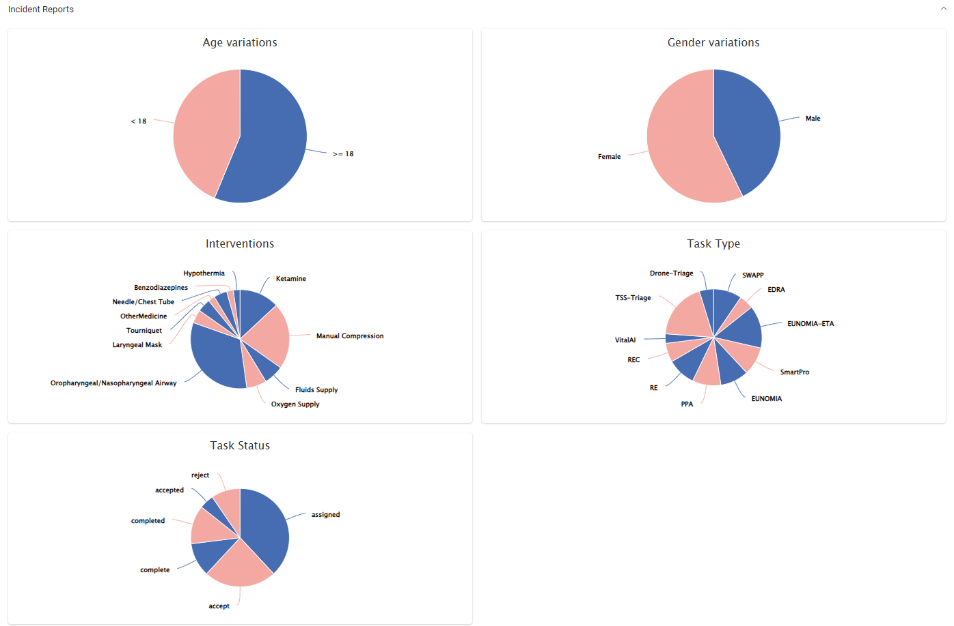
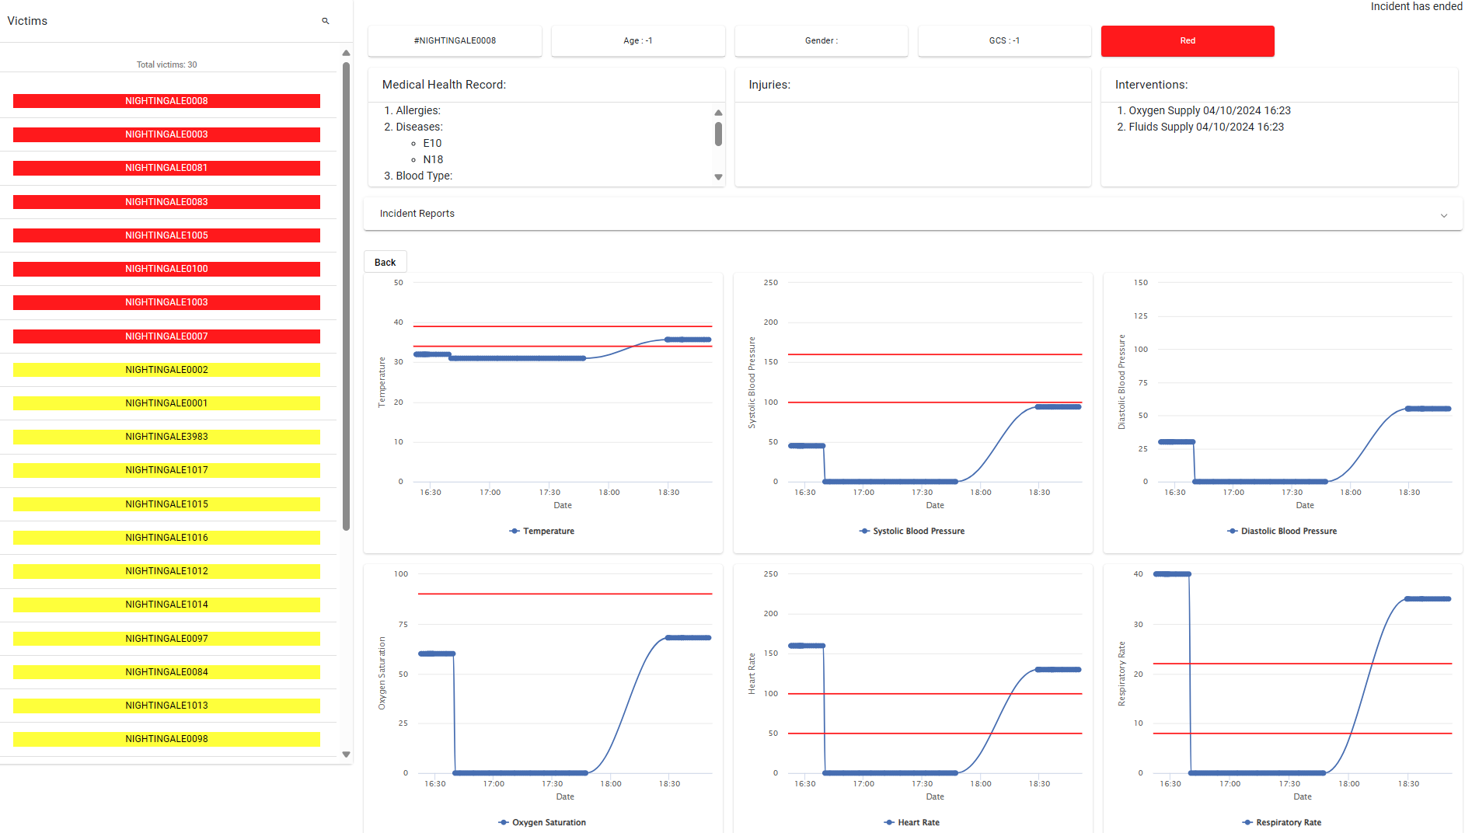
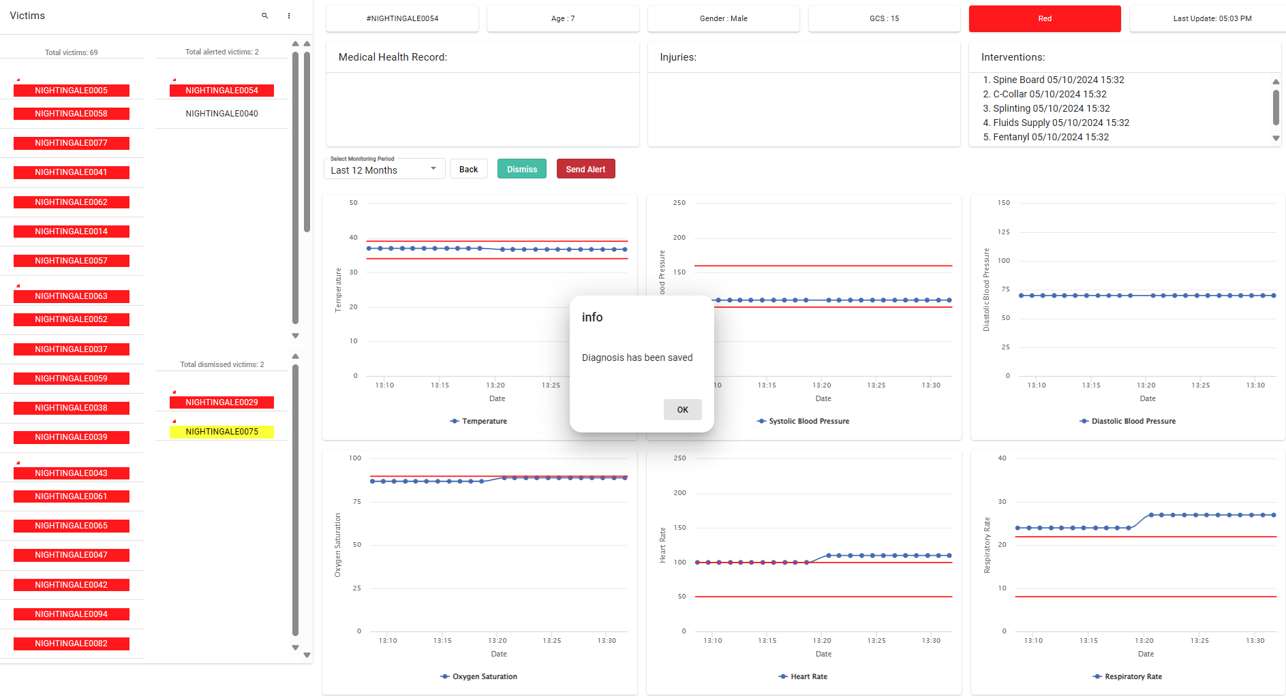
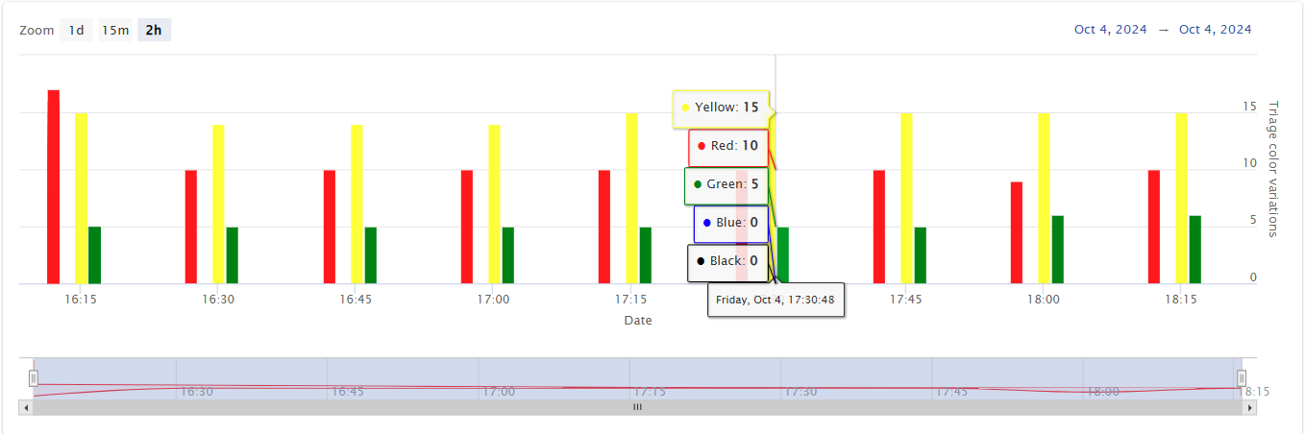

Interoperable Data Lake (IDL)
Collects and integrates existing historical or needed open data from various sources.
Aggregates, stores, and manages live triage and other data from on-field components.
Feeds data to other components for decision support, predictive modelling, querying, information retrieval, and visualization.
Provides a data-driven Decision Support System (DSS) with filtered data visualizations and real-time alerting to C3/IMS in case of abnormal monitored vitals trends and on-field sensors malfunctioning.
Operated by a Data Officer, ensuring data interoperability with unified, standards-based data descriptions and seamless access.
Post MCI aggregate statistics and report generation
Operational DSS during MCI, operated by Data Officer

Slide 18
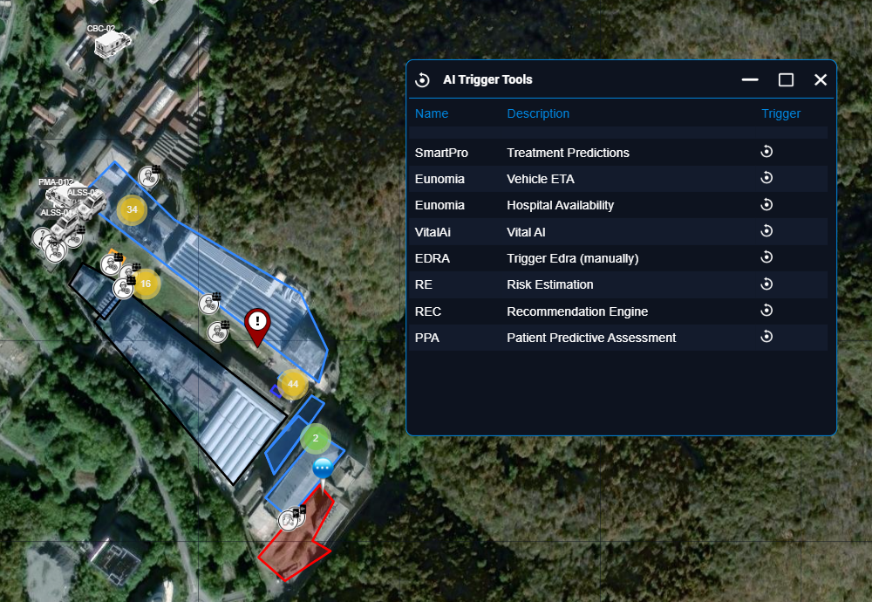
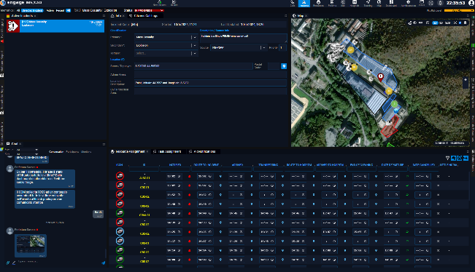

Command, Control, Coordination, and Intelligence (C3I) & Incident Management System (IMS) and Incident Commander App
The NIGHTINGALE Command, Control, Coordination, and Intelligence (C3I) & Incident Management System (IMS) is an information system used for call-taking, dispatching, tracking and administration of resources in routine and high intensity crisis management operations. It addresses Incident Management / Computer Aided Dispatch / Situation Management for optimizing the event/incident response process by ensuring that everyone in operational chain knows what is happening and what to do.
2nd FSX C3I/IMS managed a total of:
259 resources, including 110 personnel, 44 vehicles, 105 pieces of equipment, and 94 registered users across the participating agencies.
The system successfully coordinated over 100 victims/patients, leveraging its advanced resource and incident management features.
Vehicle Crew Edition, which supported hybrid simulation operations, enabling 44 agency crews to monitor their vehicles from stations to staging areas and seamlessly transition to physical operations at incident sites.

Slide 19


Scenario Builder
Creation of highly customizable, fully digital, and flexible Mass Casualty Incident (MCI) scenarios
  specifically tailored for emergency response training exercises
Real-time, comprehensive oversight of scenario dynamics as they unfold
Simulating both physical interactions and system communications
  replicates real-world complexities, including the transmission of real-time, dynamically updated vital signs for simulated patients
These metrics adjust based on the actions performed by first responders in the field, providing an immersive, responsive training environment

Slide 20

Capabilities provided
1. REAL-TIME TRACKING OF RESPONDERS
  C3/IMS
2. REAL-TIME DETECTION, MONITORING AND ANALYSIS OF THREATS AND HAZARDS
& 6. REMOTE ACQUISITION OF INFORMATION
  UAV Based Scene overview and victim counting
4. INTEGRATION OF INFORMATION
  Integration from Triage Systems, Online Sources, PSAPs and UAVs
7. REMOTE OPERATIONS
  UAVs, Thermographic System
9. ACTIONABLE INTELLIGENCE
  AI-based evolution prediction and recommendations, optimization of evacuation and use of resources in hospitals, IDL

Slide 21
NIGHTINGALE Benefits for end-uses
Capability Development
Exposure to technological advancements and their associated opportunities
Highlighted the need for updating current protocols through adoption, adaptation, and adjustment.
Training:
Opportunity for training enhancement though technology
Active participation in TTX, SSX, FSXs (~300 individual responders)
2 MACSIM Sim Exercises (for training and benchmarking)
Expanded Networks:
Networking opportunities fostered connections between community members, emergency professionals, and tech developers promoting better cooperation in future crises
5 Round Tables on Common Denominators (incl. UAB)
​

Slide 22






Training Material / Deliverables
Training Material:
Public deliverables:
https://www.nightingale-triage.eu/deliverables/
Indicative public deliverable list:
Common Denominators and New Paradigm for Trauma care in MCIs
Technology Handbook for Emergency Medical Response
NIGHTINGALE Evaluation and Lessons learned
Pre-normative and pre-standardisation activities report
Training collateral
Pre-normative and pre-standardization activities report
https://www.nightingale-triage.eu/training-material/

Slide 23



HORIZON 2020 RESEARCH PROJECT
TRIAGE
www.nightingale-triage.eu
NIGHTINGALE Project
@NGTriageEU

