Slide 1
How could continuous motoring of patients trigger a step-change in MCI handling
Dr. Spyros Athanasiadis – ICCS, member of the coordination team

Slide 2
Presentation Contents
The Challenge of Mass Casualty Incidents (MCIs)
Continues monitoring
From the field to the command center
Advantages of Continuous Patient Monitoring
Notes:
Presentation Contents

Slide 3
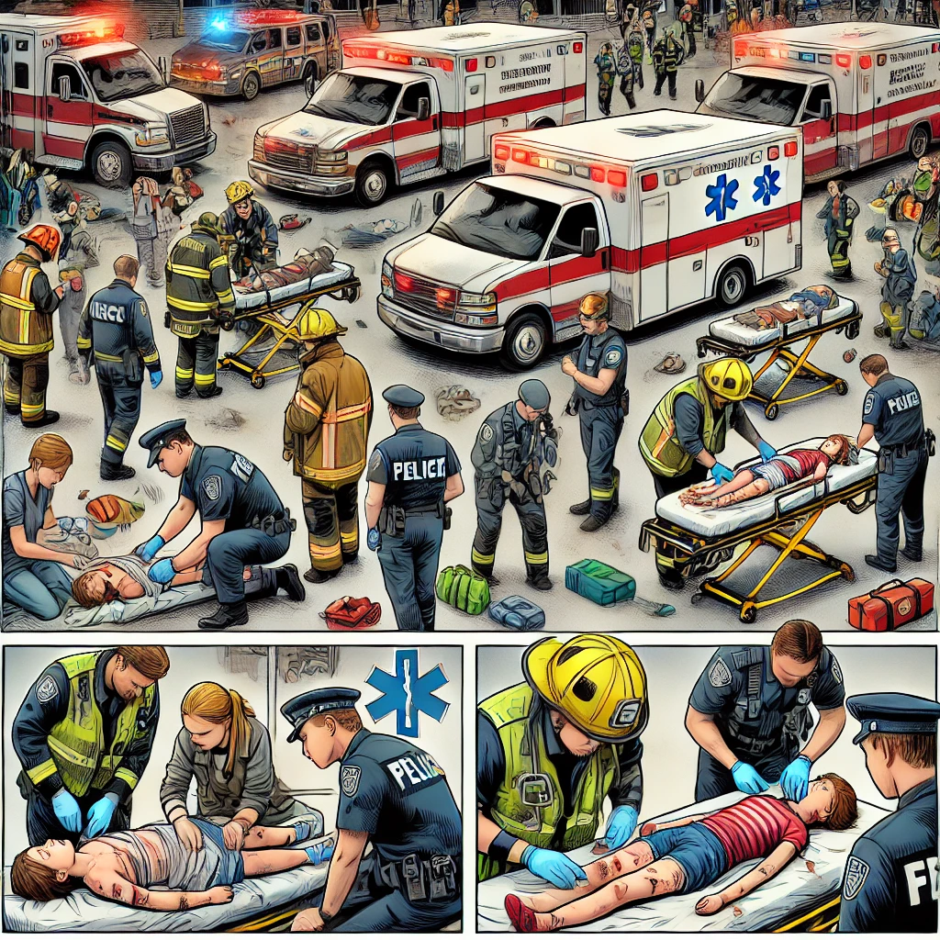
The Challenge of Mass Casualty Incidents (MCIs)
MCIs overwhelm medical responders due to high casualties
Traditional triage relies on periodic assessments, leading to delays
Need for real-time, continuous patient monitoring

Slide 4

How Continuous Monitoring Transforms MCI Response
Real-time data collection enhances situational awareness
Automated alerts enable faster intervention
Improved resource allocation for critical patients
Digital patient identification & tracking

Slide 5
The NIGHTINGALE Toolkit Overview
Digital patient identification & tracking
Mobile applications for triage and incident management
AI-driven decision support for first responders
Provide digital victim tracking capabilities including encounters with EMS responders and interventions made
Offer continuous vital signs monitoring and victim localization
Support training and evaluation through precise and detailed data collection in exercises

Slide 6
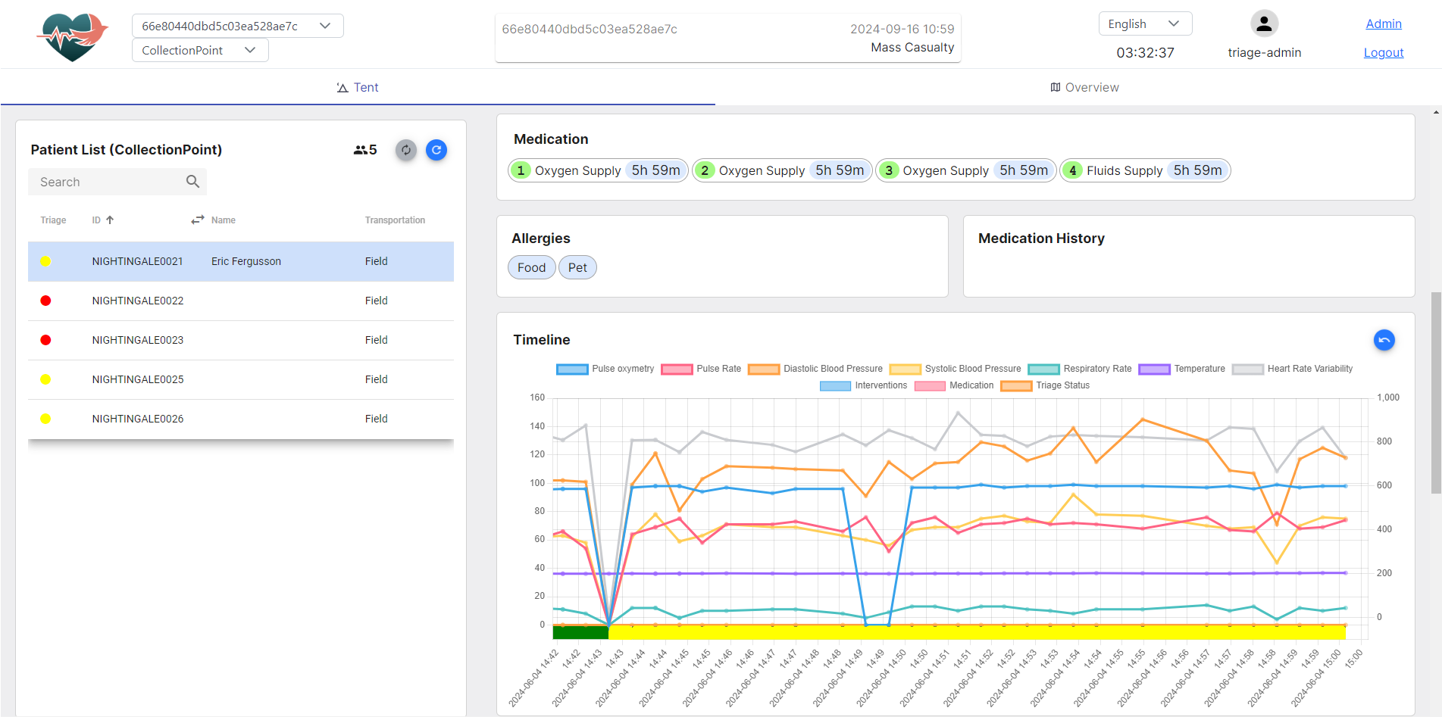
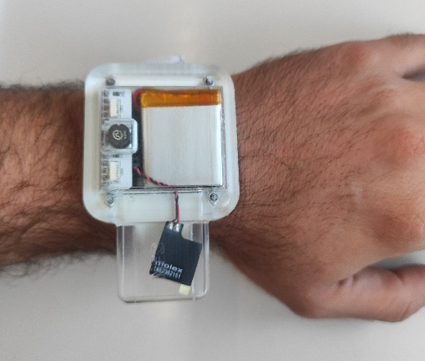
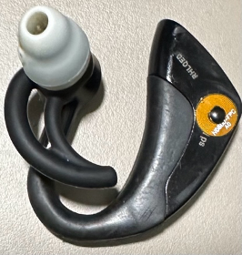
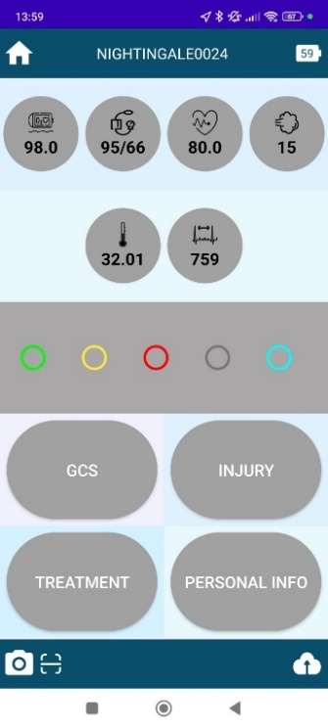
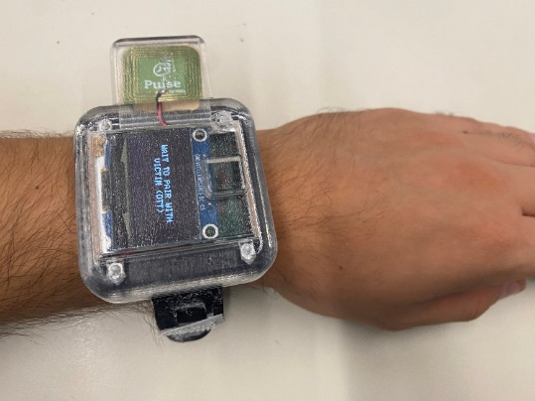
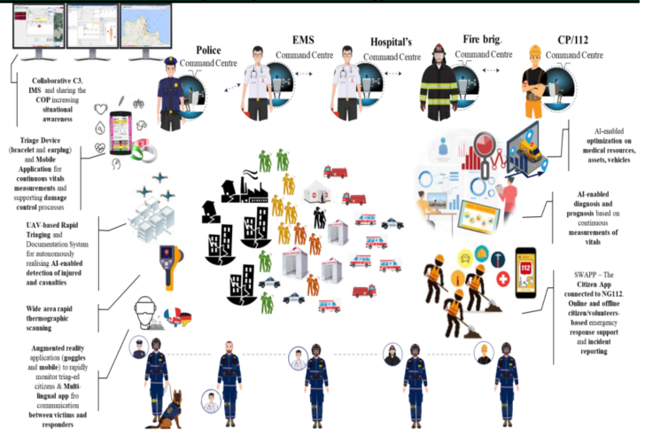
From the field to the command center

Slide 7
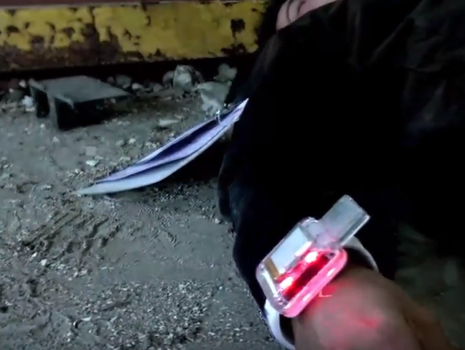
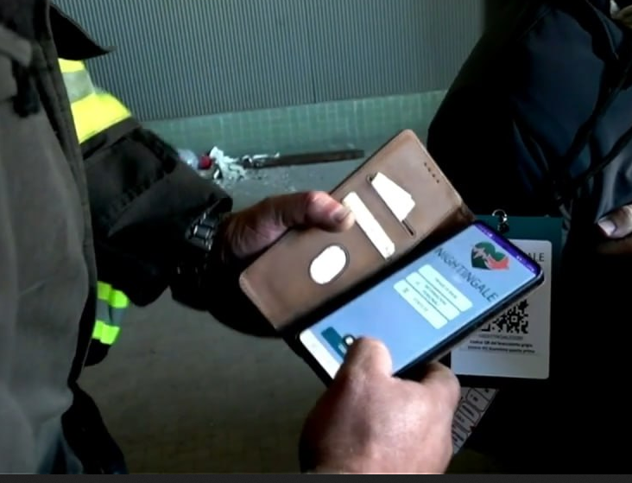
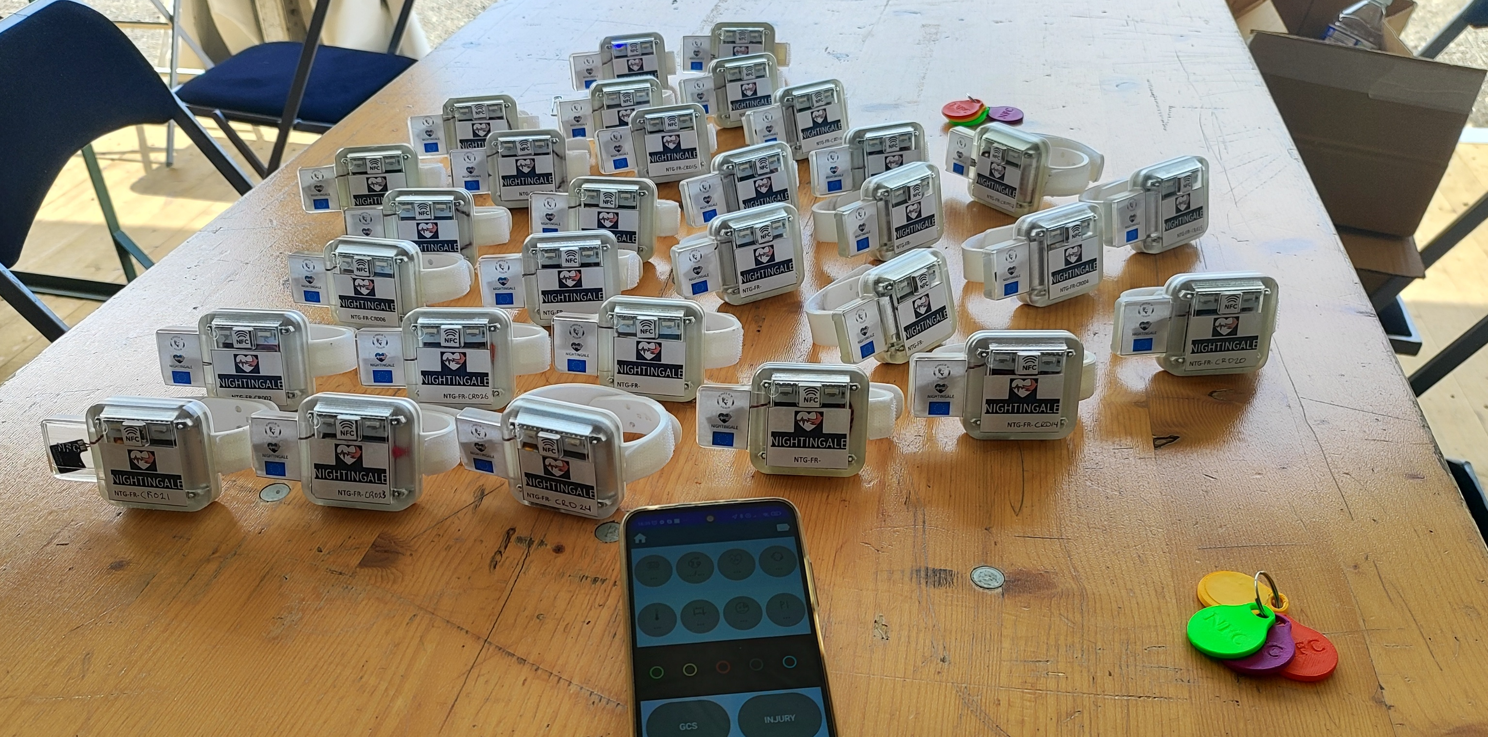
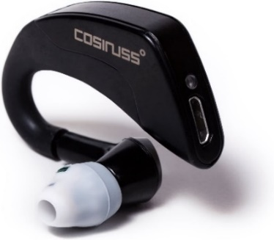
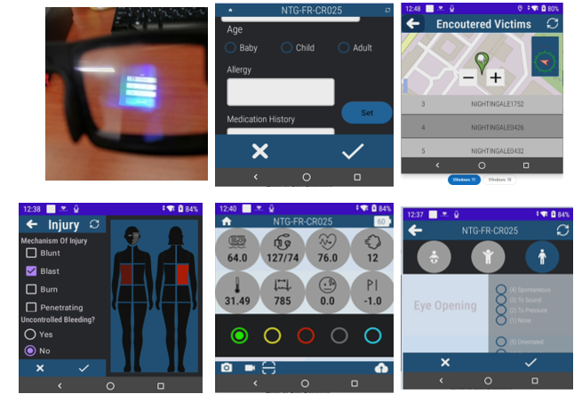



Digital Triage Toolkit – FSX2 Highlights
Successfully tested in three Trials (SSX, 2 FSX), including one involving 80 simulated victims and 200 first responders (FSX2)
FSX2 Highlights
  Stage 1 – Law enforcement/fire brigade:
  30 GREEN victims (ambulatory) registered in 6 minutes, along with name, surname, identification photographs and location.
  15 RED/YELLOW victims registered in 6 minutes with identification photographs, wounds
  Stage 2 – first Triage/Second Triage:
  Data of 90 victims monitored in real time.
  All victims registered within 38 minutes and fully monitored from that time onwards. All victims extracted to AMP in 57 minutes
  30 Victims with DTTs transmitting vitals every 30 seconds.
  Total users:
  40 law enforcement – Using light version (no medical data)
  20 fire brigade – Using light version (no medical data)
  36 medical users – Using full version
Notes:
Proven Deployment in Realistic Scenarios: The digital triage solution was successfully tested in three major exercises, including one involving 80 simulated victims and 200 first responders.
Field-Proven Reliability: Demonstrated robust functionality during multi-location deployments, confirming its viability in real-life mass casualty response scenarios.
Secure and Efficient Communication: Enabled secure and real-time data exchange between different first responder teams and command centers, promoting coordinated response efforts.
Instant Awareness and Synchronization: Upon incident reporting, all tools and agencies (varied first responder teams) were immediately notified, establishing an integrated awareness of the situation.
Real-Time Data Accessibility: Triaged victim data was instantly available to the command center and relevant agencies (e.g., hospitals, civil protection), ensuring comprehensive situational updates.
Rapid Data Transmission: Information transfer across all points—field locations, command centers, hospitals, etc.—occurred in less than two seconds, guaranteeing no data loss and swift response adaptability.

Slide 8
Advantages of Continuous Patient Monitoring
Faster diagnosis and prioritization of critical cases
Reduced medical errors through automated tracking
Enhanced coordination between emergency services
Improved survival rates in MCIs
Continuous patient monitoring is a game-changer in MCI handling
NIGHTINGALE's toolkit provides real-time data for better decision-making
Improved response times, coordination, and patient outcomes

Slide 9



HORIZON 2020 RESEARCH PROJECT
TRIAGE
Thank You
www.nightingale-triage.eu
NIGHTINGALE Project
@NGTriageEU

