Slide 1
Is multi-agency collaboration a solution to limited resources and managing the chaos?
Evangelos Sdongos – ASTRIAL
Technical Coordinator
Final Event, 16.01.2025 (online)

Slide 2
Presentation Contents
Takeaways and lessons from past MCIs
The NIGHTINGALE Approach in Multi-agency Collaboration
Results from NIGHTINGALE Exercises
Recommendations

Slide 3
1. Takeaways and lessons from past MCIs
Don’t fish in the same lake – effectively manage spatial and temporal command structure of the incident and understand how to share resources
Have your plan and further plan – keep the response plan in place and dynamically update it
Understand the evolving risks and hazards – the importance of spatially and temporally filtering and distributing incoming data and comprehending risks and opportunities
Coordinate and communicate – harvest the benefits of multi-agency collaboration

Slide 4
2. The NIGHTINGALE Approach in Multi-agency Collaboration and effective sense making
Multiple MCI Actors
  Emergency Medical Services
  Fire brigades
  Law enforcement agencies
  Civil protection local and national agencies (incl. trained volunteers)
  By-standers
Offer Incident & Information and Computer-aided Dispatch system(s) that allow:
  Filtering of incoming data from variable sources (patients, risks, hazards, planning, capacities)
  Sharing and intuitive visualization of data according to roles and responsibilities (massive data integration and access rights)
  Sharing of resources based on identified needs (annotation of use and status of resources)
  Knowing at all times number of patients and their status (optimize pre-hospital care, plan hospitalization and support communication with the public)

Slide 5
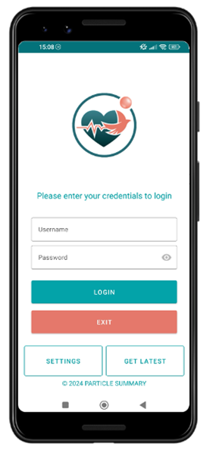
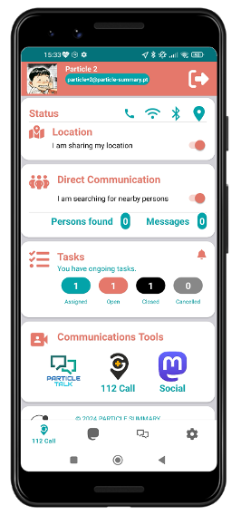
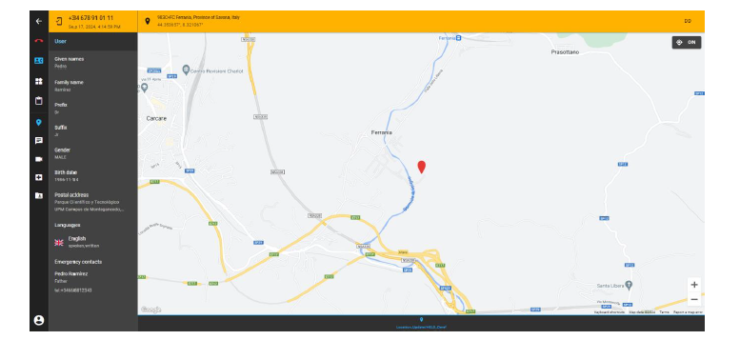
2. The NIGHTINGALE Approach in Multi-agency Collaboration and effective sense making
SWAPP: Citizen App
NG PSAP

Slide 6
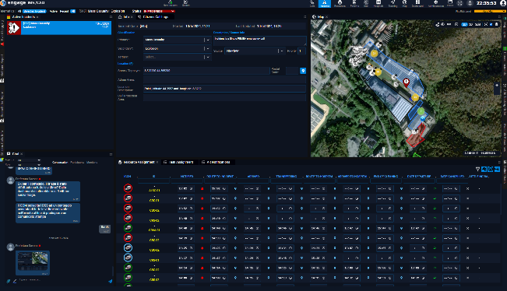
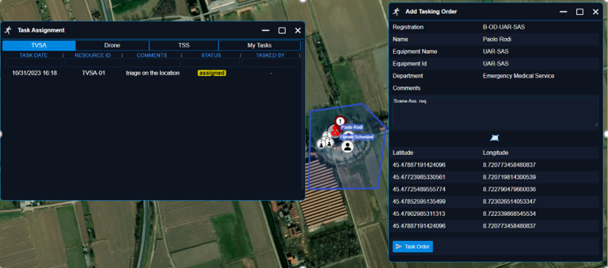
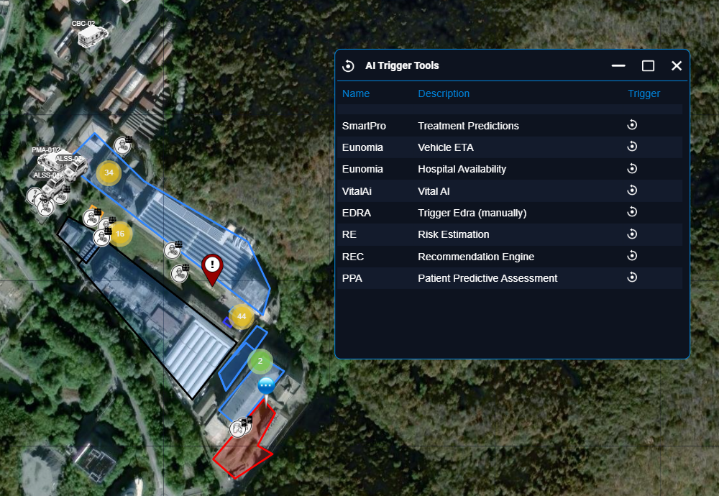
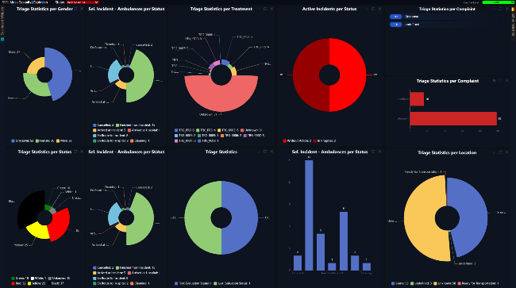
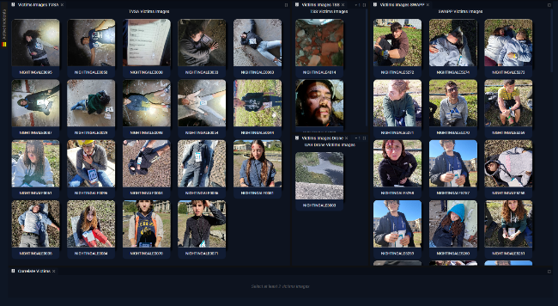
2. The NIGHTINGALE Approach in Multi-agency Collaboration and effective sense making
C3I/IMS Views
NG PSAP

Slide 7
2. The NIGHTINGALE Approach in Multi-agency Collaboration and effective sense making
SWAPP: Citizen App
ECHO
Volunteers' portal

Slide 8
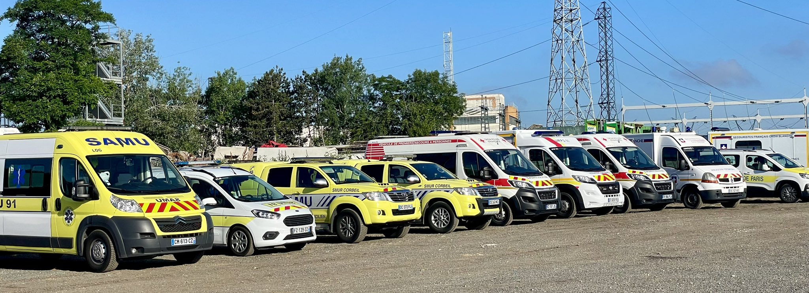
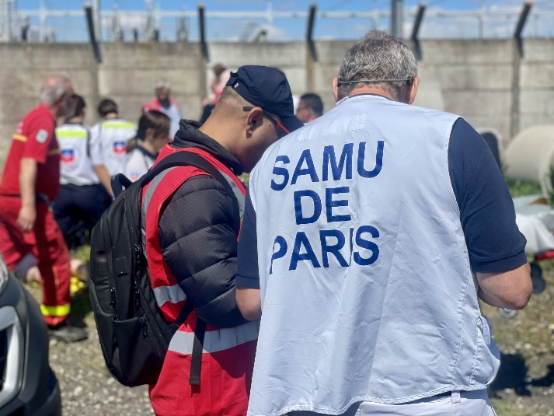
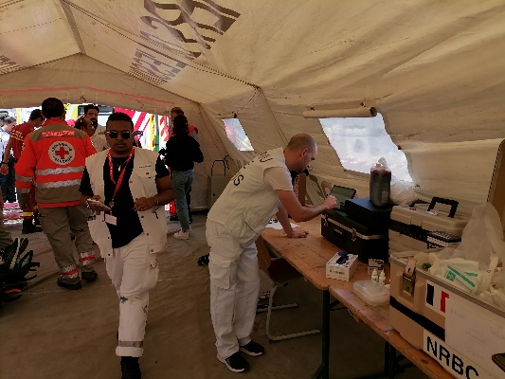
3. Highlights from NIGHTINGALE FSXs [FSX1 – June ’24, Paris]
Integration of all NIGHTINGALE Tools
2 consecutive scenarios executed
>20 EMS responders + > 5 OC operators + > 25 victims (incl. children) monitored + >10 vehicles
Prove the concept of: a) continuous triage and vitals monitoring, b) distributed information sharing, c) cross-team/agency collaboration

Slide 9
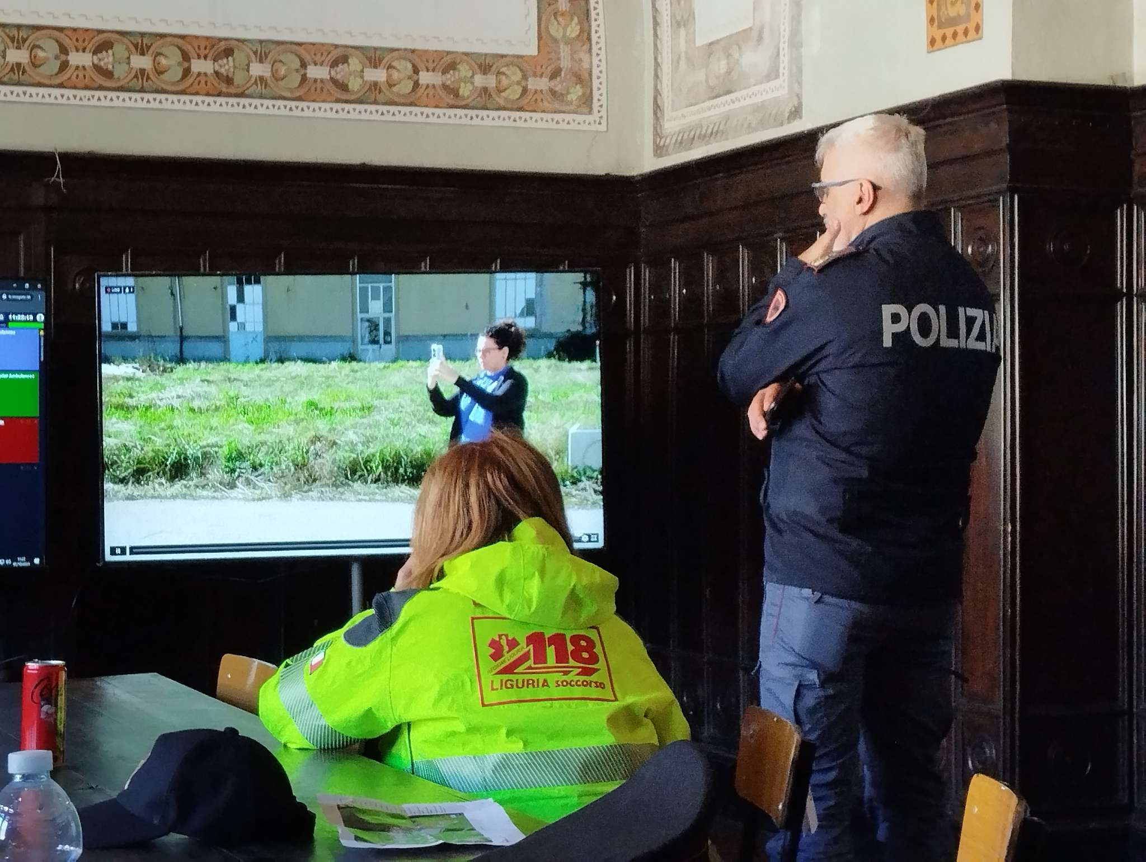
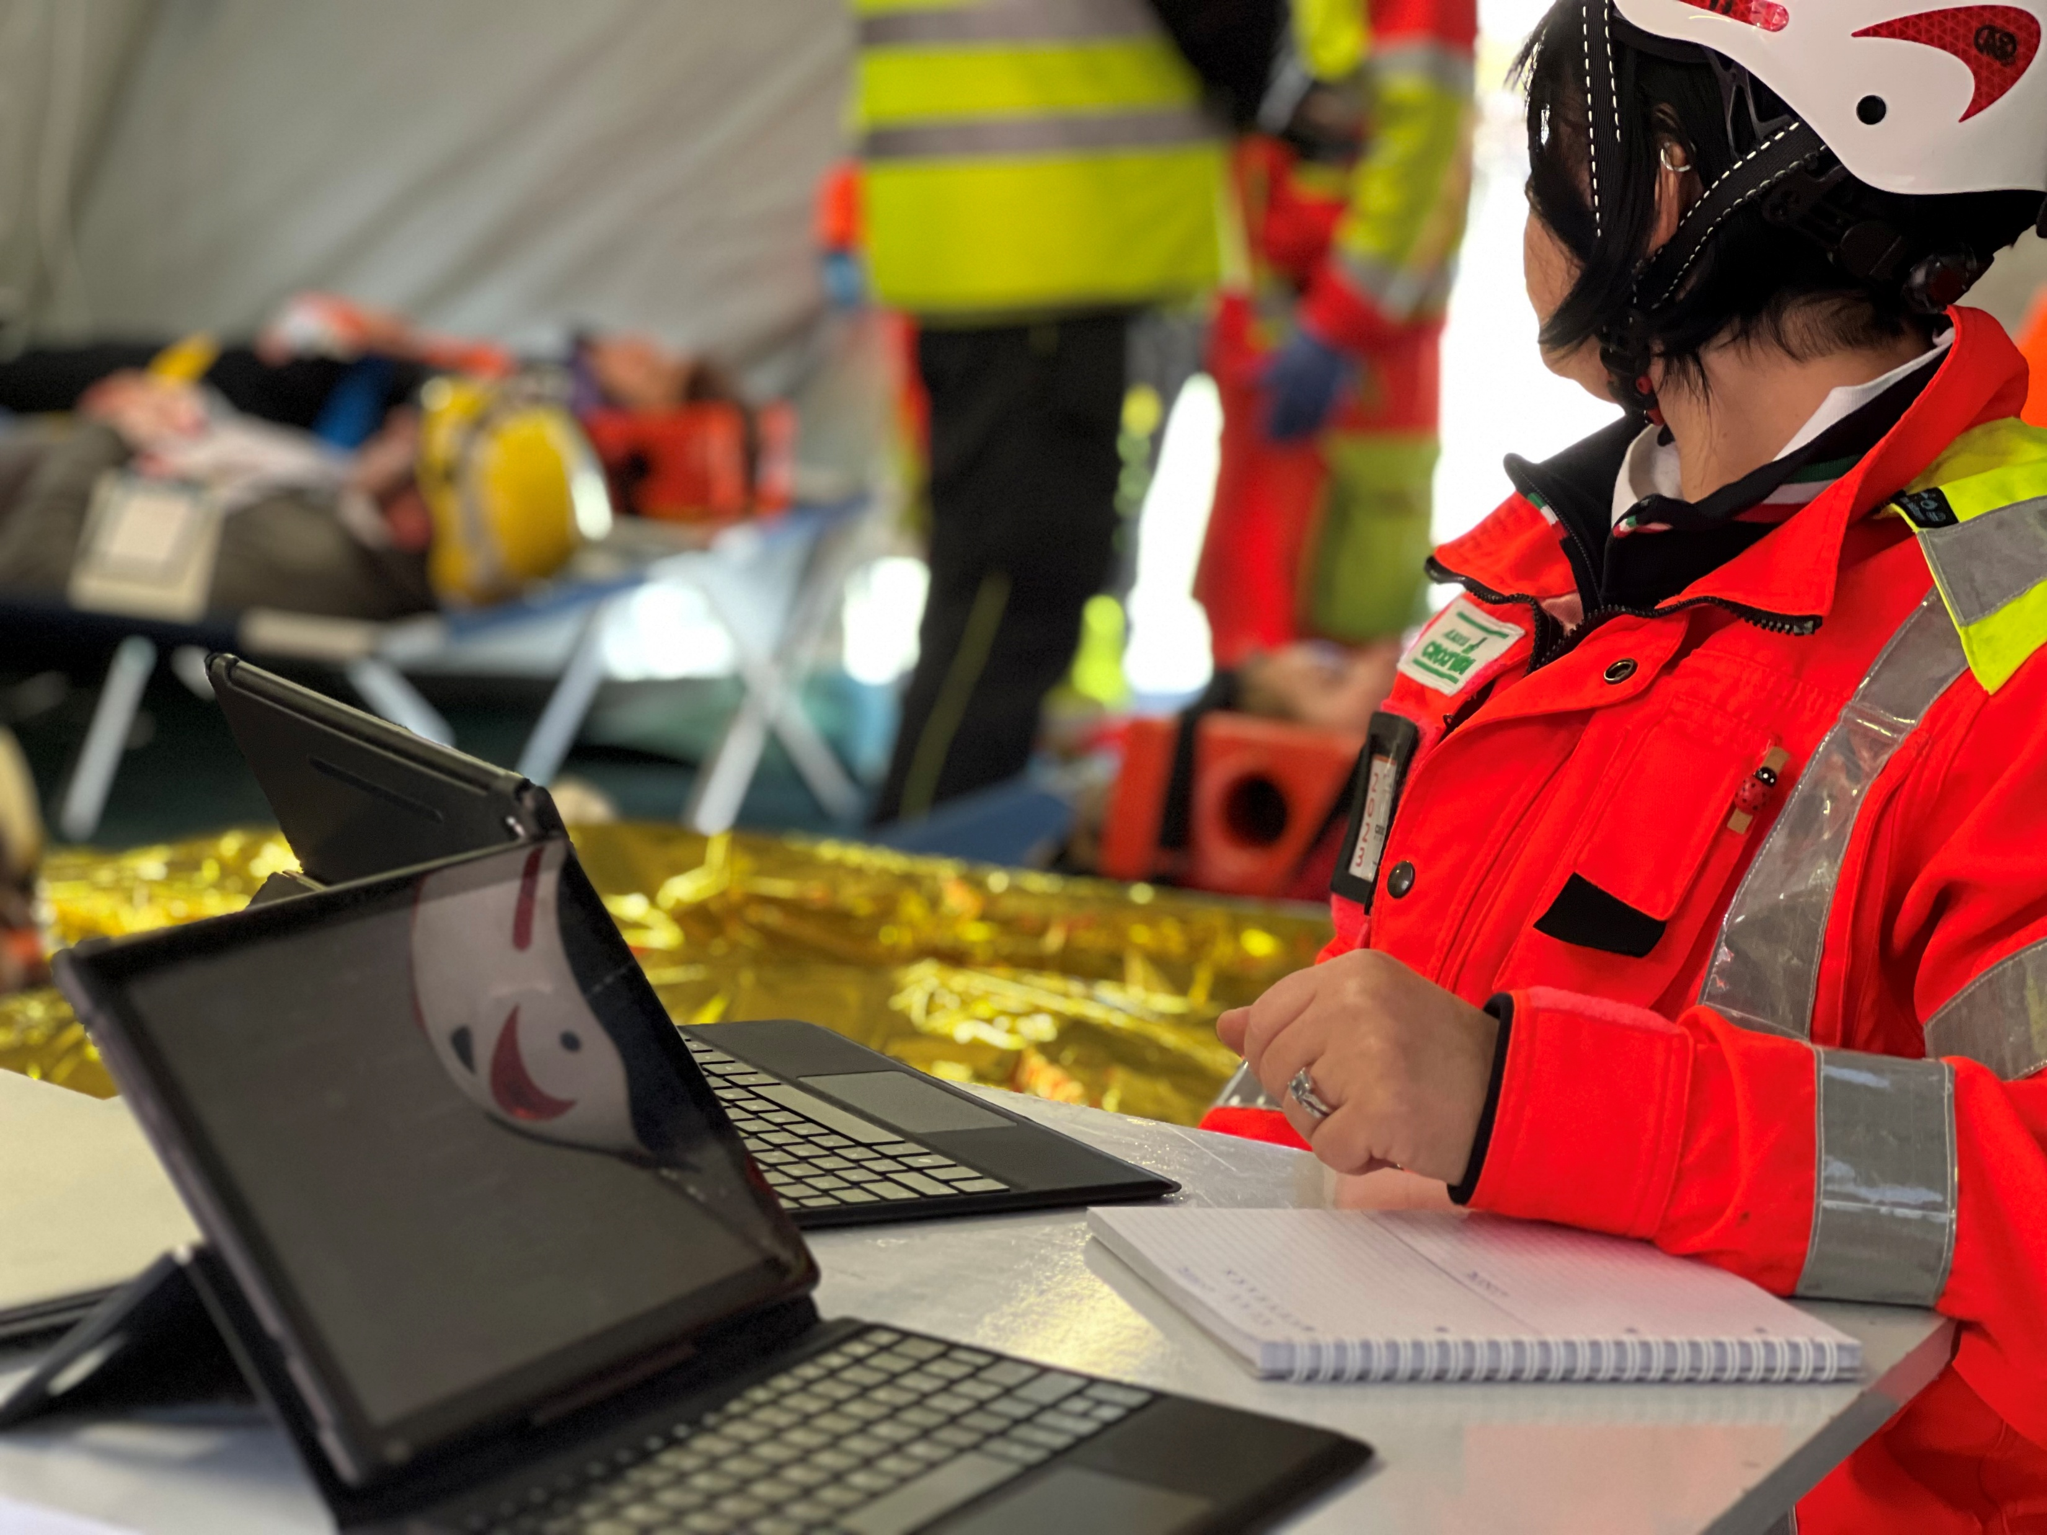
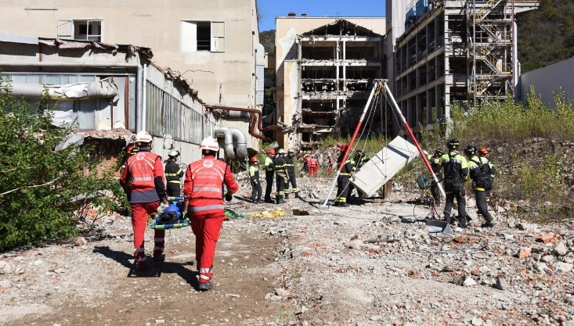
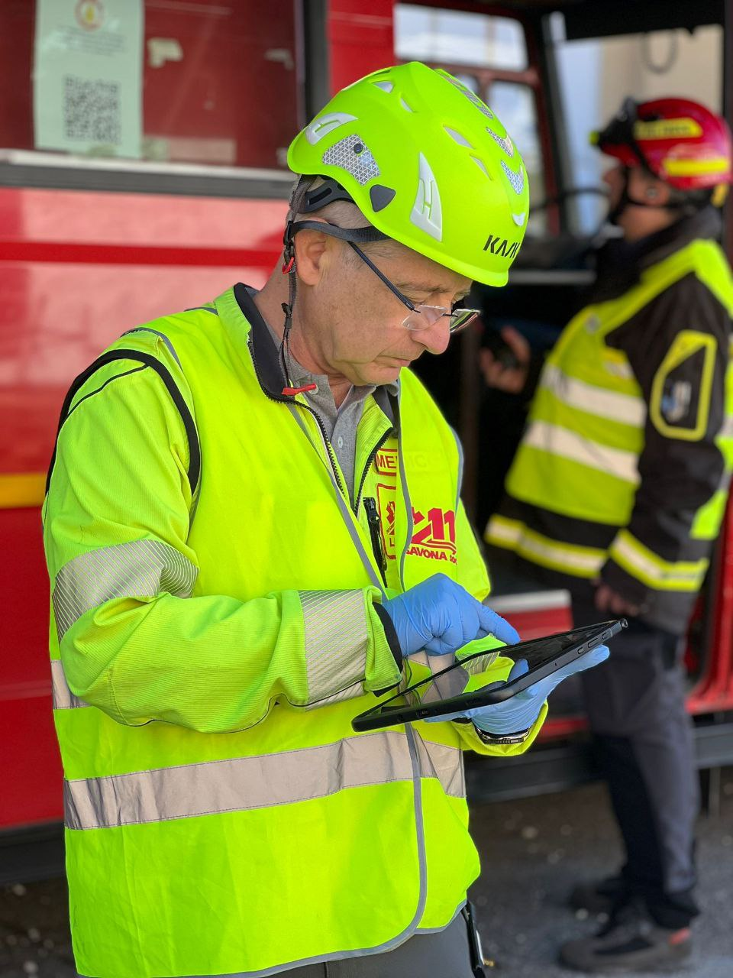
3. Highlights from NIGHTINGALE FSXs [FSX2 – October ’24, Savona]
Integration of all NIGHTINGALE Tools
5-hour duration scenario
> 50 EMS responders and >15 ambulances + > 35 Fire brigades and > 12 vehicles + > 35 police officers and >15 vehicles + > 10 volunteers + >100 victims
Stress test and validate the NIGHTINGALE system of systems

Slide 10
4. Recommendations
Interoperability is communication and information exchange – allowing agencies to effectively communicate with who they need when they need and share vital incident information across the chain of command
Put in place representative training systems – efficiently train upon and test response plans
Comprehend and manage the data – new technologies offer opportunities for enhanced situational awareness but require a well-thought use and adequate training
Make the response structure scalable – swiftly adapt to small or large sized MCIs

Slide 11
Thank You

