Slide 1
Insights from the NIGHTINGALE First Responders
Marta Caviglia – UPO
User Coordinator

Slide 2
Presentation Contents
NIGHTINGALE User Assembly
Overview of User Assembly activities
First Responders Insights

Slide 3

























PARTNERS
PROJECT
End-Users

Slide 4
1. NIGHTINGALE User Assembly
User Partners
Academic centers, Practitioners and First Responders (EMS, FF), Medical Societies, Association of volunteer citizens
User Advisory Board – UAB
Experts in the field of MCI management
Coordinated by ESTES
Coordinated by UPO

Slide 5
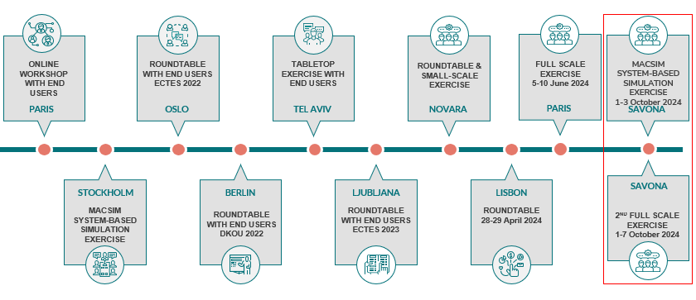
2. Overview of User Assembly activities
WP1 – Practitioners Needs & Toolkit and Architecture Design
Users Monthly Telco
Users Round Tables (RT)
NIGHTINGALE tests and field validation activities (workshops, table-top, SSX, FSX)

Slide 6

2. Overview of User Assembly activities
Gather User Needs
01
02
Define User Requirements
Support Tools’ Development
03
04
Evaluate the toolkit performance

Slide 7
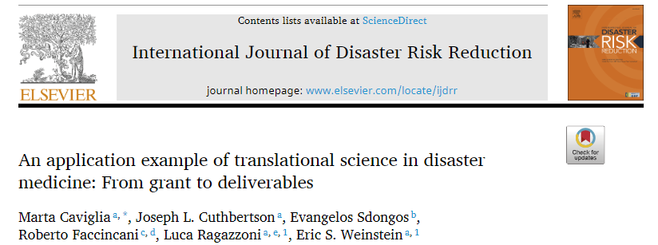
2. Overview of User Assembly activities
3 Scoping Reviews
(TRIAGE – PHLSDC – PHP)
1
Weinstein, E. S., Cuthbertson, J. L., Herbert,… Caviglia, M. (2023). Advancing the scientific study of prehospital mass casualty response through a Translational Science process: the T1 scoping literature review stage. European journal of trauma and emergency surgery : official publication of the European Trauma Society, 49(4), 1647–1660.
3 mDelphi Studies
2
Cuthbertson, J., Weinstein, E., Franc, J. … Caviglia, M. (2023). Sudden-Onset Disaster Mass-Casualty Incident Response: A Modified Delphi Study on Triage, Prehospital Life Support, and Processes. Prehospital and disaster medicine, 38(5), 570–580.
Guidelines and Reccomendation
3
NIGHTINGALE WP1 – D1.2

Slide 8
First Responders Insights

Slide 9
Recognized potential benefits of Integrating the NIT-MR tools into MCI Management
Enhanced patient outcomes – improvement in triage and timely care (aided triage, continuous monitoring, patient tracking, real time data sharing)
Increased efficiency and speed of response – integration of data-driven tool for communication and resource management
Improved preparedness and training – provision of realistic simulations and data for exercises
Better coordination among agencies – use of integrated data communication systems
Ongoing evaluation and improvement – allow retrospective analysis of data collected and stored
Adaptability to future challenges – potential for a customizable approach to evolving MCI scenarios

Slide 10
Challenges in integrating technology to MCI management
The application of MCI technology in such complex contexts might necessitate openness to change (protocols, paradigms)

Slide 11
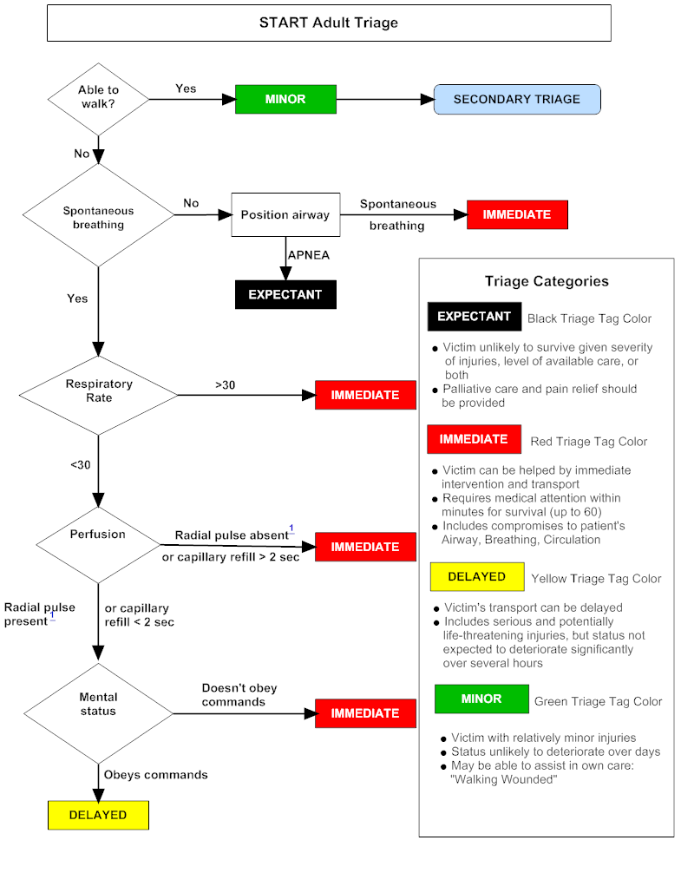
Challenges in integrating technology to MCI management
The application of MCI technology in such complex contexts might necessitate openness to change (protocols, paradigms)

Slide 12

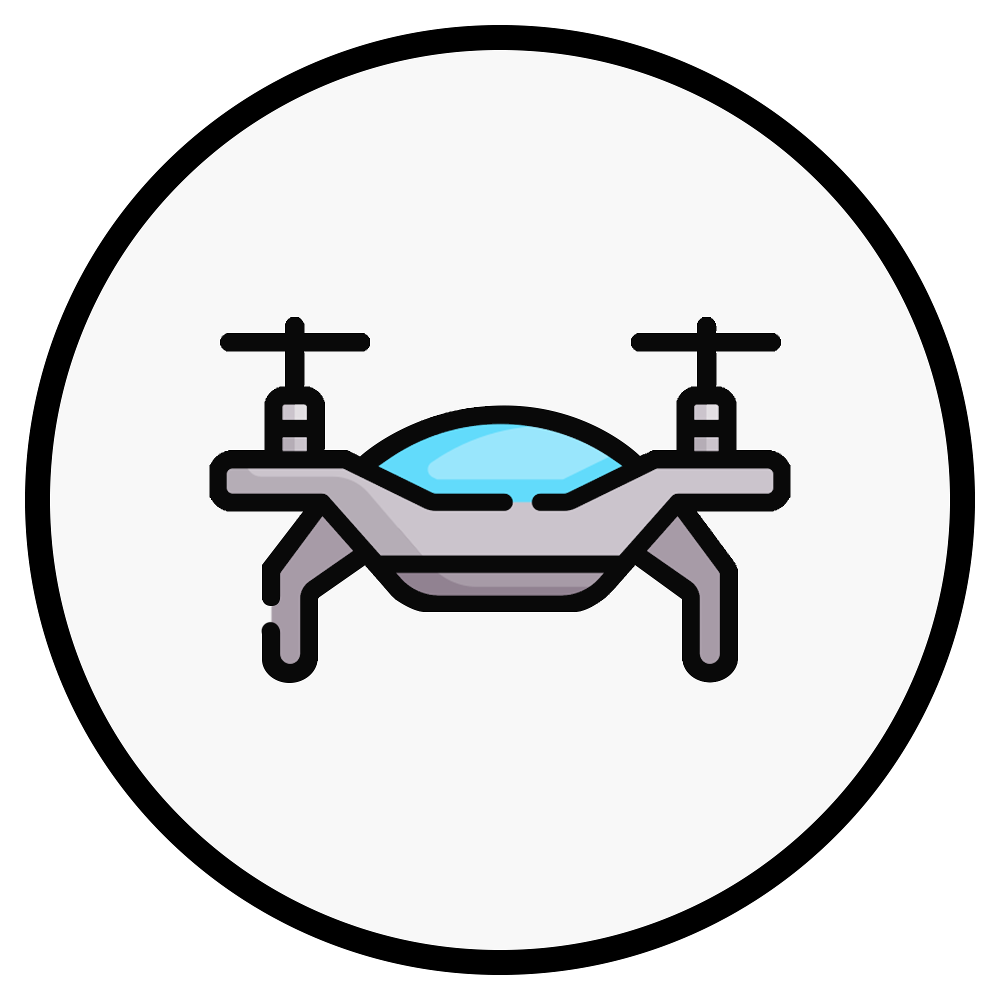



Challenges in integrating technology to MCI management
The application of MCI technology in such complex contexts might necessitate openness to change (protocols, paradigms)
SpO2, BP, HR, T°C, RR

Slide 13
Challenges in integrating technology to MCI management
The application of MCI technology in such complex contexts might necessitate openness to change (protocols, paradigms)
BANDWITH
Cognitive Load

Slide 14
Challenges in integrating technology to MCI management
The application of MCI technology in such complex contexts might necessitate openness to change (protocols, paradigms)
This changes cannot be sudden and abrupt: a gradual integration ensures that the established workflows of first responders are not entirely disrupted but progressively supported
BANDWITH
Cognitive Load

Slide 15
Challenges in integrating technology to MCI management
The application of MCI technology in such complex contexts might necessitate openness to change (protocols, paradigms)
This changes cannot be sudden and abrupt: a gradual integration ensures that the established workflows of first responders are not entirely disrupted but progressively supported
Technology should serve first responders, not burden them

Slide 16

Challenges in integrating technology to MCI management
The application of MCI technology MCI should consider:
Legal
Framework (Data protection)
Infrastructures
Accessibility and costs
Trust
Continuous
Education & Training
Tech alphabetization

Slide 17
Challenges in integrating technology to MCI management
The application of MCI technology MCI should consider:
Legal
Framework (Data protection)
Infrastructures
Accessibility and costs
What CRITERIA should be followed when introducing new technologies for MCI & Disaster Response?
Trust
Continuous
Education & Training
Tech alphabetization

Slide 18
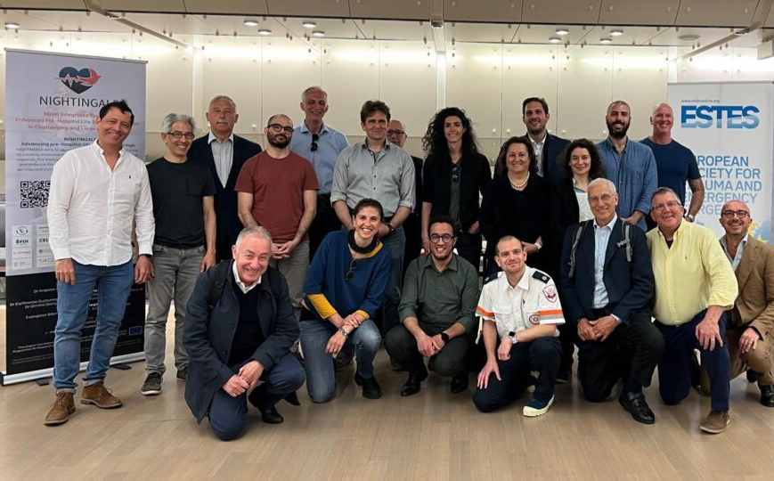
What CRITERIA should be followed when introducing new technologies for MCI & Disaster Response?
NIGHTINGALE Decision Making Checklist
What is the current need or gap that this new technology will address/satisfy?
What is required of the new technology? (use in routinary activity, interoperability, security)
What are the basic maintenance requirements (including ease of repair and spare parts)?
What competencies are required to use the new technology?
With a Cost-benefit analysis are the costs acceptable for your agency or jurisdiction?
What will be the main ethical concerns?
What is the new technology environmental impact?
NIGHTINGALE - Users Round Table
Ljubljana 5-6 May 2023

Slide 19
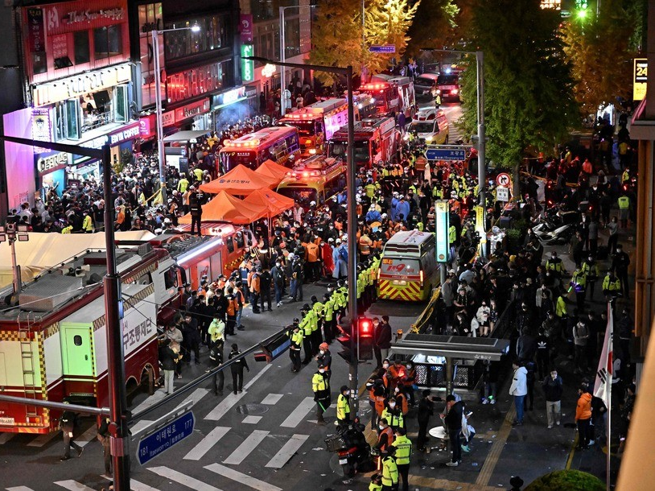

Challenges in integrating technology to MCI management
MCI Technology could lead to an overload of information, difficult to navigate to handle acute response phases

Slide 20

Challenges in integrating technology to MCI management
MCI Technology could lead to an overload of information, difficult to navigate to handle acute response phases
Definition of new roles & responsibilities: the “Data Officer”

Slide 21
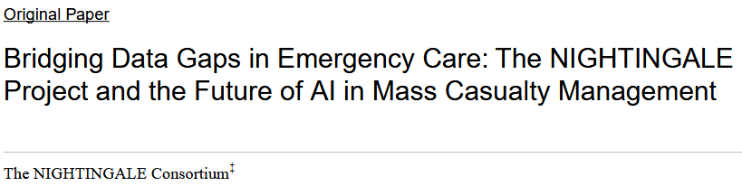

Challenges in integrating technology to MCI management
The integration of AI in MCI response holds great potential, yet it requires careful consideration
QUALITY
QUANTITY
Leverage transfer learning
Enhance pre-hospital data collection mechanisms
Build strategic partnership

Slide 22
Thank You

