Slide 1
The DIREKTION Project and the DIREKTION Assessment and Screening Framework (DASF)
Louise Vos, TNO DSS
16.01.2025, NIGHTINGALE FINAL EVENT

Slide 2
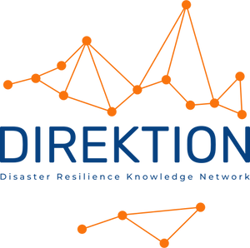
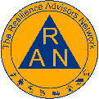
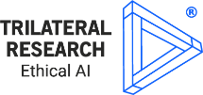
Disaster Resilience Knowledge Network promoting innovation, technology uptake and multi-stakeholder cooperation
Call: HORIZON-CL3-2022-SSRI-01-02 Coordinator: INERIS DEVELOPPEMENT Duration: 36 months (10/2023 – 09/2026)
This project has received funding from the European Union’s Horizon Europe research and innovation programme under grant agreement No 101121249.

Slide 3
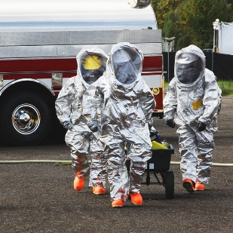
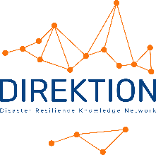
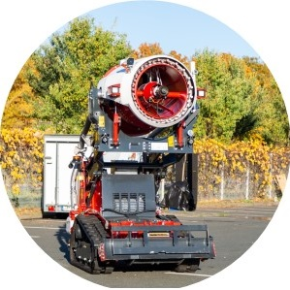
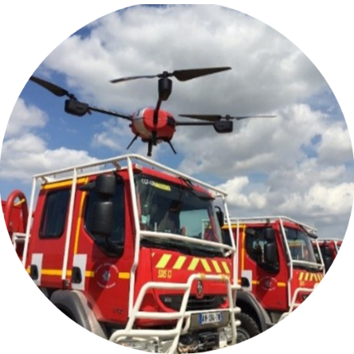
Disaster Resilience Knowledge Network
promoting innovation, technology uptake and multi-stakeholder cooperation
Understand needs from responders at all levels and all situations
Manage the Network of networks
Program EU-funded security research
Promote, share existing knowledge and address new audiences
Ensure sustainability
Support technology development
Create an environment for co-development of innovative solutions
Support the market uptake
Funded by the European Union

Slide 4
Disaster Resilience Knowledge Network
promoting innovation, technology uptake and multi-stakeholder cooperation
Procedures and tools for gap analysis and solution assessment
Procedures for project outcome evaluation
Tools for linking innovation to responder needs
Method for research priority recommendations
A sustainable CMINE-based platform
Enhanced practitioner involvement in disaster resilience
Collaboration with CTIF, FEU and responder organisations to enhance innovation development and uptake
Funded by the European Union

Slide 5
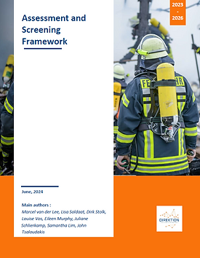
DIREKTION Assessment and Screening Framework (DASF)
https://www.direktion-network.org/dasf

Slide 6
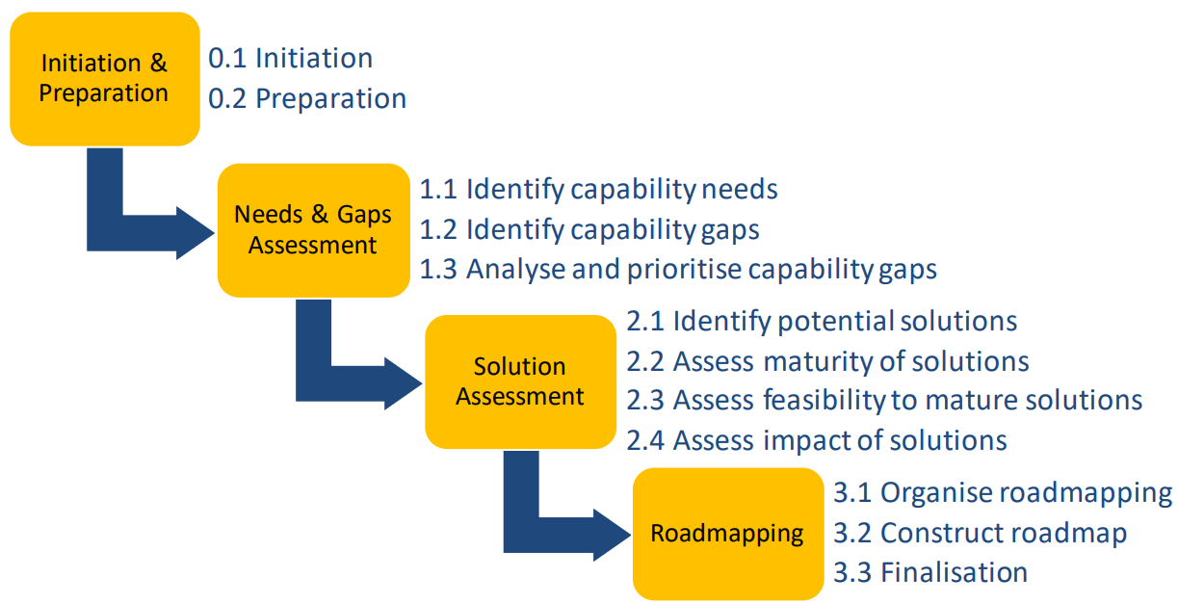
Objectives of the DIREKTION Assessment and Screening Framework (DASF)
The DASF framework is designed to offer a step-by-step method to:
Identify and address Capability Gaps and Improvement Needs
Implement Systematic Screening and Assessment of Technologies and Solutions
Set-up a roadmap

Slide 7
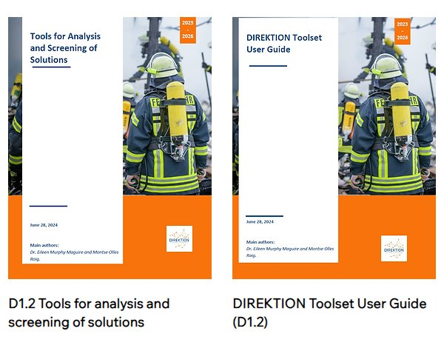
The DASF Toolset
The DASF toolset consists of core tools designed to simplify and systematize the assessment and screening process for disaster management
Capability Needs and Gaps Assessment Tool
A user-friendly tool that allows disaster management agencies to assess their current capabilities against standardized benchmarks.
……………………………………….
Solution Assessment Tool
This tool evaluates the maturity, feasibility, and potential impact of solutions. It is based on established criteria such as TRLs and operational feasibility.

Slide 8
How the Framework Works
The DASF is a comprehensive tool that uses a step-by-step methodology
#1 – Initiation and Preparation
Stakeholders are brought together to define the scope of the disaster management assessment.
Identifying the relevant disaster types, such as natural hazards or man-made risks.
#2 – Needs and Gaps Assessment
Identifying the capability gaps that hinder effective disaster response.
Using the tool to assess current capabilities and compare them against pre-defined disaster management standards.
#3 – Solution Assessment
Identified gaps are addressed by evaluating potential technological and operational solutions.
Using the tool assess aspects such as the technology readiness level (TRL), feasibility, and potential impact of the solutions.
#4 – Roadmapping
Connecting assessment results to long-term planning and policy development.
Supporting EU institutions in aligning future research and funding programs with critical disaster resilience needs.
Ensuring solutions are identified, scaled and sustained across various disaster contexts and regions.

Slide 9
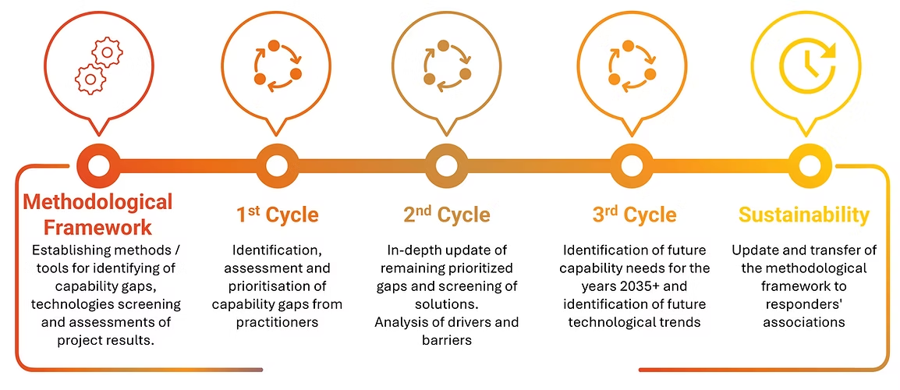
Using the DASF and Next Steps
DASF Application in DIREKTION Project Key Findings:
TRL Framework
Suppliers are unfamiliar; more guidance is needed.
Adaptability and User-Friendliness
Solutions should involve end-users in development.
Seamless Integration
Important for adoption.
Legal and Ethical Standards
Crucial for future solutions, especially with AI and data analytics.
Final version reported by 2026
Post-project potential applications:
Other DRS projects
DG HOME
Member States
End-user umbrella organizations

Slide 10
Visit our website
We invite you to read the deliverables.
Your input is essential to help us refine these resource.
https://www.direktion-network.org/dasf
Apply for the Open Call 2025
https://www.direktion-network.org/awards

Slide 11
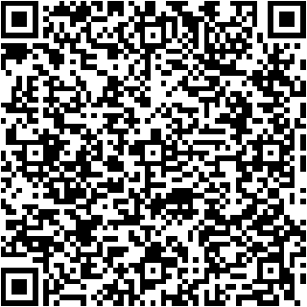
www.direktion-network.org
@DIREKTIONnet
Louise.vos@tno.nl
olivier.salvi@ineris-developpement.com
bastien.caillard@ineris-developpement.com
Subscribe to our newsletter
Funded by the European Union

