Slide 1
Final Event 16 January 2025
What AI and predictive analyses can offer to improving MCIs?
Prepared by: FOI, LDO, INOV, EXUS, CERTH, TREE
Presented by: tiago.r.silva@inov.pt

Slide 2
Agenda

Slide 3
Agenda
Introduction,
Mass Casualty Incidents (MCIs) and their challenges
Novel Integrated Toolkit for Emergency Medical Response (NIT-MR) AI and Predictive Analytics components and services
key tools and technology focus on impact for MCIs
Challenges and Limitations
Future work\directions
Notes:
Novel Integrated Toolkit for Emergency Medical Response (NIT-MR)

Slide 4
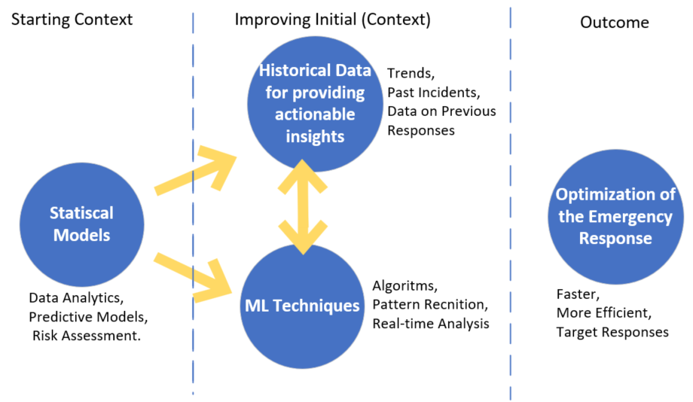
Introduction, Mass Casualty Incidents (MCIs) and their challenges
MCIs can range from a few dozen to thousands of victims, causing pressure on resources e.g.: FRs, transports, hospitals and other critical infrastructures. They often involve a mixture of traumatic injuries, medical conditions and environmental factors where getting an overview from the field of the situation as soon as possible is essential.
Challenges that NIT-MR AI and Predictive Analytics components and services can help: accelerate knowledge of the scale of the crisis; resource allocation; time sensitivity, information overload.
The NIT-MR AI and Predictive Analytics offer promising solutions. These tools provide real-time insights, rapid scene assessment, forecast resource needs, and improve the decision-making process during these complex, high-pressure events. Let's explore how these technologies transform MCI response.
Notes:
Novel Toolkit for Emergency Medical Response (NIT-MR)

Slide 5
The NIT-MR AI and Predictive Analytics components and services
key tools and technology focus on impact for MCIs
Notes:
Novel Integrated Toolkit for Emergency Medical Response (NIT-MR)

Slide 6
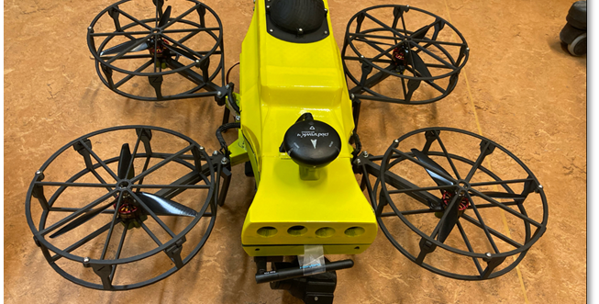
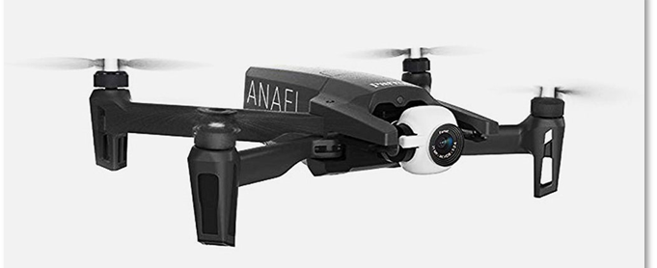
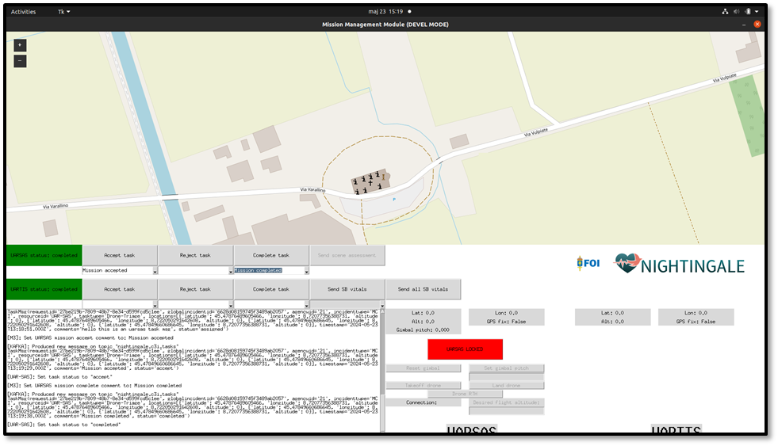
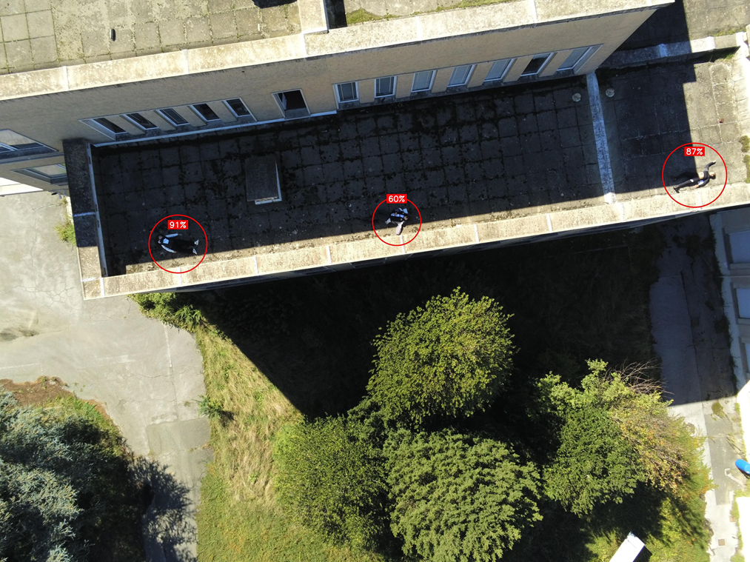
Unmanned aerial systems
UAR-SAS, UAR-TIS, M3, and the other analysis components are especially designed to be used by first responders in MCI-scenarios to obtain better overview and increase the medical situational awareness. Functionality include, but not limited to:
Mission communication, Drone status, Automatic task area assignment, etc.
Automatic object detection, position estimation, and situational threshold adaption
Estimation of vital parameters, respiration rate (RR), Hard Rate (HR)
UAR-TIS
M3
UAR-SAS
Notes:
FOI UAR-SAS:: Unmanned Aerial Rapid - Scene Assessment System
UAR-TIS:: Unmanned Aerial Remote - Triage Indicator and vital parameter estimation System
M3:: Mission Management Module

Slide 7
VitalAI
Objective: estimation of the probability of survival of patients in the next hours and ranks from most to least critical patients.
Based on machine learning algorithms related to survival analysis.
Information needed:
Patient vitals (temperature, heart rate, respiratory rate...)
Pateint information (age, sex).

Slide 8
Vital Sign and Early Warning Prognosis - SmartPro
Objective: Monitor vital signs in real time and provide predictions for the current and future health status of an affected individual, assisting the triage process.
Three main functions:
Calculates a prognosis on the evolution of vital signs per individual (SPO2, heart rate, respiratory rate, SBP, DBP and shock index), using:
Deep learning LSTM models, learning and finetuning as time goes on
Machine learning Naïve Drift model cluster for early predictions
Computes severity early warning scores based on the current measured vital signs and the computed vital sign prognosis
Generates ABC (Airway, Breathing, Circulation) alerts and potential need for medical intervention
Notes:
INOV
SpO2 - Pulse Oximeter Oxygen Saturation SBP - Systolic Blood Pressure
DBP - Diastolic Blood Pressure
SI – Shock index = Hard rate \ SBP (0.5- 0.7)
STM - Long Short-Term Memory

Slide 9
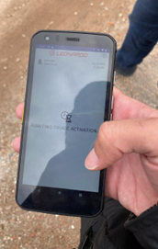
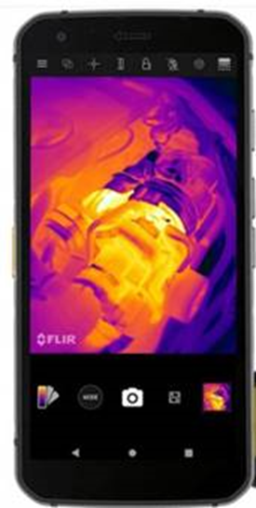
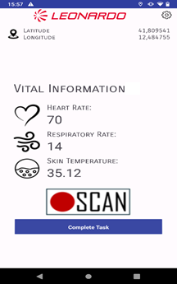
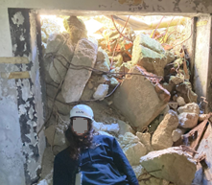
Thermographic Scanning System
The Thermographic Scanning System (TSS) is specifically designed to be utilized by First Responders (FRs) for initial triage operations
With this tool FRs can seamlessly share crucial information, such as the patient's location, photos, and vital parameters in a non-contact manner, particularly useful in cases were is not possible or not safe to use medical devices that need to be physically applied to casualties
Vitals parameters are extracted using Machine Learning algorithms
The TSS vital sign monitoring includes the following components:
a rugged smartphone (Cat S62 Pro) with thermal camera embedded;
an Android APP to acquire data and show the results;
a backend application that includes a machine learning model that analyses video and picture received from the APP in order extract heart rate, respiratory rate and skin temperature
In the 2° Full scale Exercise, the TSS was used by Urban Search and Rescue (USAR) operators for casualties under the rubble who could only be approached at a minimal distance
Edge Device (Cat S62 Pro)
Notes:
LDO
USAR - Urban Search and Rescue

Slide 10
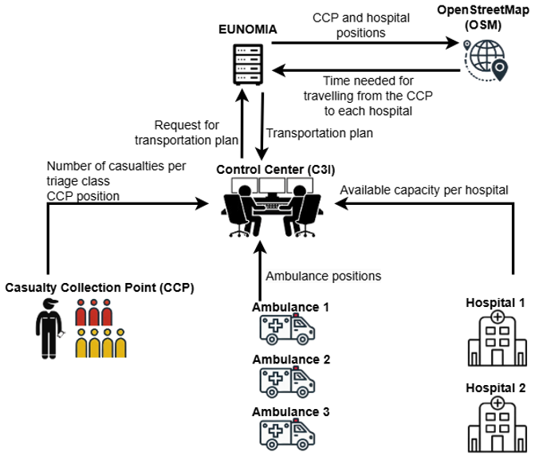
Resources and assets optimisation service: EUNOMIA
Objective: Determine the transportation plan that maximizes the number of survivors.
Transportation plan determines the:
Victim transportation order: the type of victim (based on triage level and trauma type) that should be prioritized for loading into each ambulance.
Hospital Allocation: the exact hospital where each victim should be delivered according to hospital capacities.
Ambulance Scheduling: the expected arrival times of ambulances at the Casualty Collection Point (CCP) and the hospitals, considering:
Initial position of the ambulances.
Round-trip operations, as ambulances repeatedly shuttle victims from the CCP to hospitals.
Notes:
CERTH

Slide 11
Emergency Department Resource Allocation (EDRA)
Objective: generate treatment schedules in real time for patients according to patient acquity, the treatment the patient needs and hospital avaliable resources.
Based on Markov Decision Processes (MDP) and reinforcement learning.
Information needed:
Patient estimated arrival time.
Patient triage level.
Hospital resources.
Treatment path.
Notes:
TREE

Slide 12
Risk Estimation module (RE)
Objective: Optimize traditional triage processes by prioritizing the order in which patients receive attention based on real-time vitals and historical data analysis.
RE module uses classification algorithms trained on the Niguarda Dataset to predict a triage code (Red, Yellow, or Green) for each patient. Each prediction is accompanied by a probability that reflects the model’s assessment of the patient’s condition severity. These AI-generated triage codes work alongside field assessments, enhancing triage decisions without replacing the professional judgment of healthcare providers.
Information needed:
Patients vital signs.
Patient triage status.
Notes:
EXUS

Slide 13
NIT-MR AI and Predictive Analytics components and services
AI-driven triage systems
Unmanned Aerial Remote Triage Indicator and vital parameter estimation System (UAR-TIS), detection of injured persons based on body position, movement, temperature and image-based extracted features such as blood or bones; Positioning of individuals; Autonomous navigation around possible injured people; Respiration rate detection; Pulse detection
SmartPro service, current state (Real-time monitoring ) of individuals and provides vital prognosis information, enabling early detection of patient conditions
Thermographic Scanning System, FRs can seamlessly share crucial information, such as the patient's location, photos, and vital parameters in a non-contact manner
Predictive modelling for resource demand
VitalAI service, Risk Estimation (RE) provides mortality prediction information
SmartPro service, RE enabling early detection of patient conditions
EUNOMIA, provides the transport Estimated Time of Arrival (ETA)
EDRA, provides scheduling for patient treatment based on defined treatment path
PPARE, Patient predictive assessment and RE, enhance the efficiency of emergency medical response operations.
Decision support systems for emergency responder
Unmanned Aerial Rapid Scene Assessment System (UAR-SAS): Exploration of the affected area, object detection
EUNOMIA, information on transport, vehicle/ambulances schedules and availability of these resources (fundamental information for allocating these types of resources).
Notes:
UAR-SAS:: Unmanned Aerial Rapid - Scene Assessment System
UAR-TIS:: Unmanned Aerial Remote - Triage Indicator and vital parameter estimation System
SmartPro service :: . Its primary function is to assist the triage process by providing the first responders with information on the current state of individuals affected by a specific MCI, as well as giving a prognosis on the future evolution of their vital signs

Slide 14
Challenges and Limitations
Using AI within the medical field requires access to representative and preferably also balanced data – Which is a challenge within the MCI domain.
Data availability, the data is necessary to verify the AI models.
Data is often also needed to train the AI models. Within MCI the available data is often not suitable or representative for the situation
A discussion on what kind/degree of errors are acceptable is needed.
AI based system that are trained using reinforcement learning (RL).
Maintenance of human autonomy (AI tools must act as decision support systems)
Smooth and resilient data transmission (e.g. satellite communication, 5G)
Transparency and interpretability in the recommendations (explainable AI)
Ethical and legal concerns (unbiased recommendations, protection of personal data)

Slide 15
Future work\directions
There are many exiting venues for future work with drone-based systems UAR-SAS (Unmanned Aerial Rapid Scene Assessment System) and UAR-TIS (Unmanned Aerial Remote Triage Indicator and vital parameter estimation). For example:
increasing the automation aspects, e.g., automatic calculations of flight paths, area coverage, automatic drone positioning, ...
making a swarm-based system to increase area coverage and detection and estimation speed
Minimizing the UAR-TIS system
Changing the deliverance system to a ground-based system, e.g., a "dog“
Refining and optimizing AI algorithms with data generated by a toolkit like Nightingale. By enhancing the dataset with more relevant and high-quality data, we can continue to train AI models that produce more accurate and effective results.

Slide 16
Thank you

