Slide 1
SYNERGISE - increasing emergency services safety and efficiency
Tiina Ristmäe
THW

Slide 2
SYNERGISE project overview
Main scope: improving first responder (FR) safety and capabilities by developing innovative technologies
Health and wellbeing of FR
Wearable sensors
Consortium of 18 partners from Europe, Japan and Korea
Supporting and side activities in SYNERGISE
Human-Machine teaming
Ethical aspects when using wearables and working with robots
International collaboration
Collaboration with IFAFRI and E-STAG
Rich technology field testing by FR
Location of FR
Wearable devices
Safe operations
Remote operations with the help of robots, AR
Funded by European Commission and partners from Switzerland, Korea and Japan
Efficient decision making
Field communications, AI, Command & Control, integrated system
www.project-synergise.eu

Slide 3
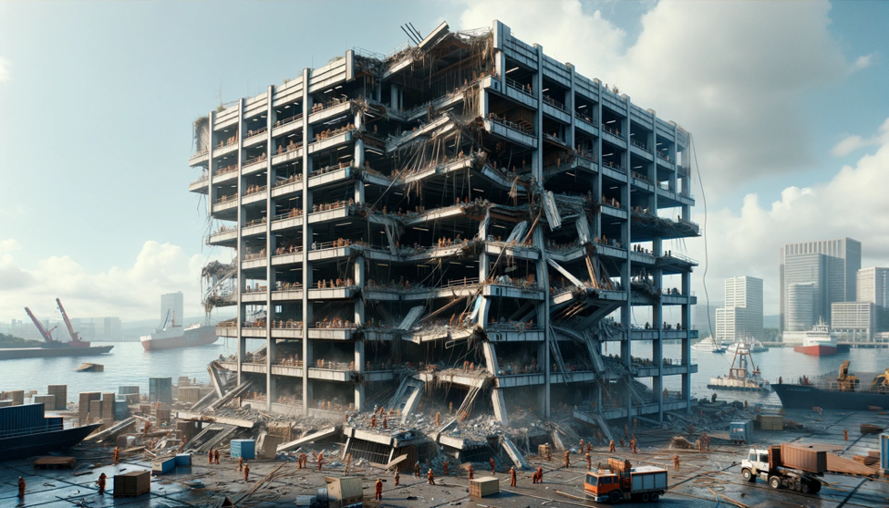
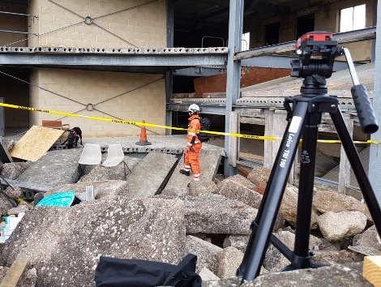
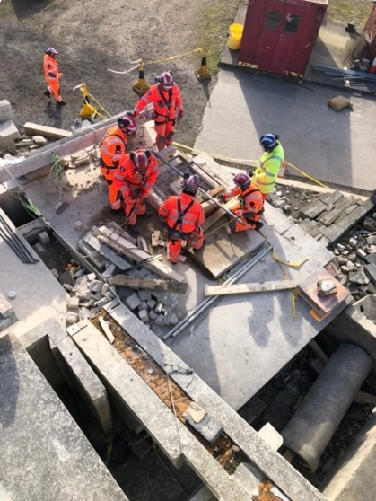
SYNERGISE MASTER SCENARIO - Beirut Port Explosion
Search & Rescue Use cases
Fire & rescue use cases
S&R + F&R Use cases
Search & Rescue Use cases
Fire&rescue use cases
S&R+F&R Use cases
Use Case example:
A team has been assigned by the Urban Search and Rescue Coordination Cell (UCC) to a worksite at one of the port office buildings to carry out rapid search & rescue. Severe structural collapse of office building with about 10.000m² total space: steel frame and reinforces concrete walls, floors – victim location and rescue. Complete Worksite identification form and triage forms.

Slide 4
Capability analyse example
Capability | Current assets | SYNERGISE solutions | SYNERGISE Impact
Information gathering | Binoculars UAVs Thermal image cameras Ladders Open-source data (e.g. Google maps) Communication with locals Personal tallies Survey 123 | UAVs (indoor/outdoor) FR localisation devices Field communications Information Management System | Increased FR safety Remote operations Stabile communications Efficient multi-agency information exchange
Evaluation of the building structure | Laser monitors UAVs Binoculars Visual observations | UAVs (indoor/outdoor) FR localisation devices FR wearables for providing FR Wellness Index Field communications Information Management System | Increased FR safety Remote operations Stabile communications Increased efficiency collecting and analysing the data Efficient information exchange
Victim localisation | Loud hailer Visual search | Indoor drone OWL Ground robot ANYMAL FR localisation devices FR wearables for Providing FR Wellness Index Field communications Information Management System | Increased FR safety Remote operations Increased efficiency collecting and analysing the data

Slide 5
SYNERGISE Testing concept
SYNERGISE key result:
A fully tested and validated integrated toolkit for improving first responder safety and capabilities
Lab tests
01
Online exchange meetings to:
introduce the technology,
discuss the current stand and
analyze the FR requirements
10 lab tests
Component field tests
02
Single components are tested by FR on the realistic field conditions against the use cases.
Feedback is provided using the evaluation methodology
Altogether five Component Field tests will be implemented
System field tests
03
Field tests for integrated solutions. Hands on testing in the realistic environment, the whole system is evaluated based on the SYNERGISE use cases

Slide 6
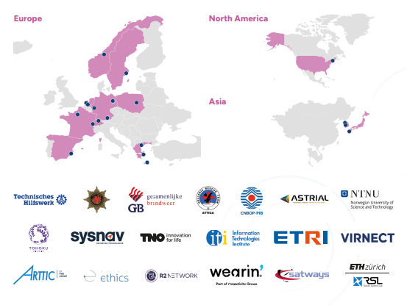
Thank you!
www.synergise-project.eu

